Slide 1
Welcome
👋
Learningpath and introduction to
Safe AI on every desk with Microsoft 365 Copilot Chat
v1.00 24.11.2025
Notes:
Welcome to Safe AI on every desk with Microsoft 365 Copilot Chat. Great you are here! This Learningpath equips you with everything you need to superpower your workday with generative AI.
Click next to begin.

Slide 2
Introduction
This Learning path will guide you through the topic of generative artificial intelligence in the context of work.
The goal is to not only help you understand what all of this is about, but especially how you, as a user, can benefit.
With Microsoft 365 Copilot Chat, you have generative AI right on your fingertips. Approved by the company and safe to use, this is the tool you should be using when handling work related documents and data.
This is going to be exciting, let‘s get started!

Slide 3
Module overview
explore
Introduction to generative AI, responsible use principles and overview of Microsoft 365 Copilot Chat. First steps in prompting, best practises and overall walkthrough.
endavour
Microsoft 365 Copilot Chat within your daily business. We will be diving deeper in to the possibilities and functionality and how it can ease your day to day work.
enrich
Building on previous modules, we will focus on advanced usage scenarios, not only for yourself, but also for collaboration within the team and beyond.
expand
In this module it is not only about Microsoft 365 Copilot Chat itself, but about introducing generative AI in processes and how to extend functionality and value.
Closing
Almost done, we will cover additional material and resources so that you can keep on moving.
Notes:
The course is set up in 4 modules, building on each other.
Explore: Introduction to generative AI, responsible AI principles and first steps with Microsoft 365 Copilot Chat as well as prompting and best practises.
Endavour: AI within your daily business. We will dive deeper into the possibilities and functionality and how it can ease your day to day work.
Enrich: We will focus on advanced usage scenarios, not only for yourself, but also for collaboration within the team and beyond.
Expand: Introducing generative AI in processes and how to extend functionality and value.
Within the final closing we will wrap up the topics and provide further resources for information and skilling.
Let's dive in!

Slide 4
Module 1 - Explore
What is generative AI
Foundations of responsible AI
Why security is key – and why you can trust it
How to access Microsoft 365 Copilot Chat
How to navigate Microsoft 365 Copilot Chat
Notes:
Welcome to Module 1. In the next minutes we want to explore what generative artificial intelligence means, how it can help to reduce stress and how to get started.
Click next to continue.

Slide 5
What is generative ai
Generative AI uses large language models (LLMs), which are AI systems trained on massive amounts of text, to understand and generate human-like language
It focuses on creating new, unique content, based on the input you provide
This input is called prompting, which just means asking AI for specific things
It can even produce creative content, such as writing poems, composing melodies, or designing graphics, based on the patterns and styles it learned
Generative AI can simplify everyday tasks and enhances productivity substantially if being used smart and often
🔎
If you are interested in diving deeper into the foundations, follow this external link.
Notes:
What is generative ai
Generative AI uses large language models (LLMs), which are AI systems trained on massive amounts of text, to understand and generate human-like language
It focuses on creating new, unique content, based on the input you provide.
This input is called prompting, which just means asking AI for specific things.
It can even produce creative content, such as writing poems, composing melodies, or designing graphics, based on the patterns and styles it learned.
Generative AI can simplify everyday tasks and enhances productivity substantially if being used smart and often.
If you are interested in diving deeper into the foundations, follow this external link.
To continue click next

Slide 6
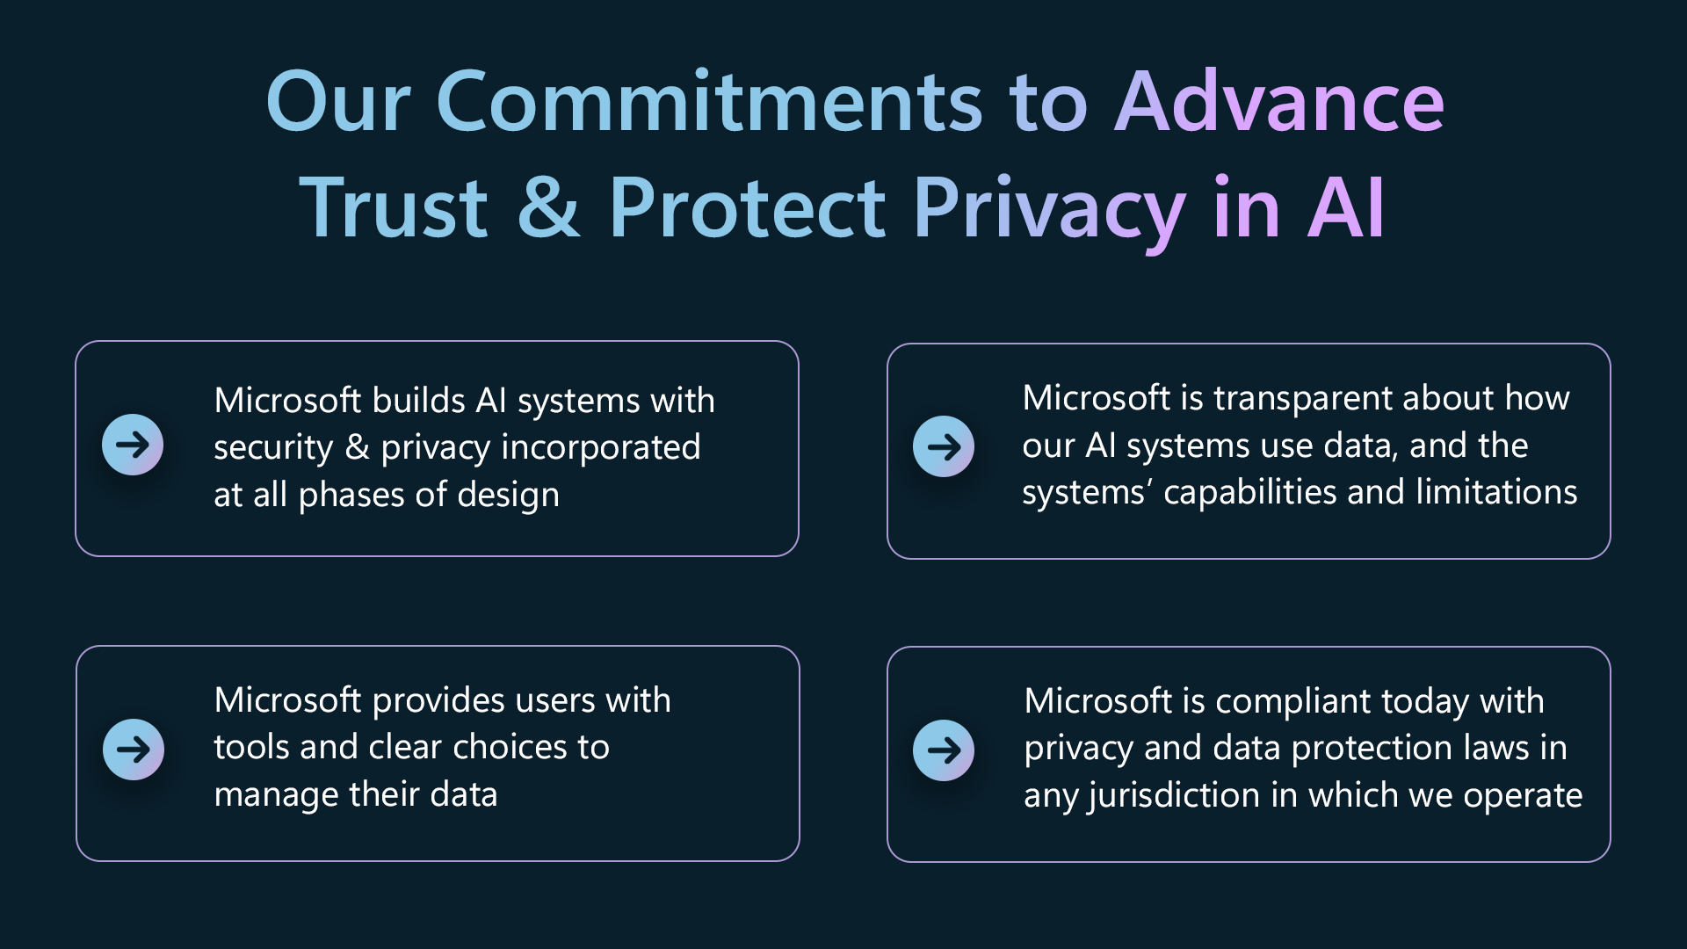
Responsible ai
Microsofts “Responsible AI standard” consolidates essential practices to ensure compliance with emerging AI laws and regulations. It is based on six main principles, every development is committed to
Fairness: AI systems should treat all people fairly
Reliability and Safety: AI systems should perform reliably and safely
Privacy and Security: AI systems should be secure & respect privacy
Inclusiveness: AI systems should empower everyone and engage all people, regardless of their backgrounds
Transparency: AI systems should be understandable
Accountability: People should be accountable for AI systems
Source: Microsoft Blog Enhancing trust and protecting privacy in the AI era
If you are interested in diving deeper into Microsofts approach on Responsible AI, follow this external link.
Notes:
Responsible ai
Microsofts “Responsible AI standard” consolidates essential practices to ensure compliance with emerging AI laws and regulations. It is based on six main principles, every development is committed to
Fairness: AI systems should treat all people fairly
Reliability and Safety: AI systems should perform reliably and safely
Privacy and Security: AI systems should be secure & respect privacy
Inclusiveness: AI systems should empower everyone and engage all people, regardless of their backgrounds
Transparency: AI systems should be understandable
Accountability: People should be accountable for AI systems
If you are interested in diving deeper into Microsofts approach on Responsible AI, follow this external link.
To continue click next

Slide 7
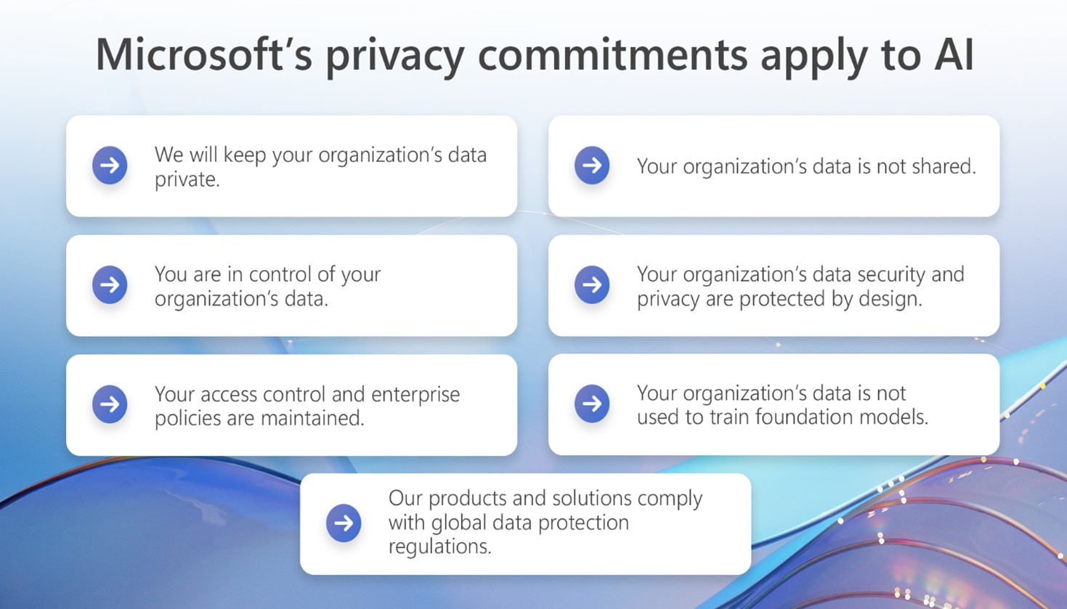
Safe ai
Microsoft has a long-standing practice of protecting customers’ information. The approach of Responsible AI is built on the foundation of dedication to core values of privacy, security, and safety in all generative AI products and solutions.
Your data will be kept private
You are in control of your organizations data
Your access control and policies are maintained
Your organizations data is not shared
Your organization’s data privacy and security are protected by design
Your organization’s data is not used to train foundation models
Microsofts products and solutions continue to comply with global data protection regulations
Source: Microsoft Blog Protecting the data of our commercial and public sector customers in the AI era
If you are interested in diving deeper into Microsofts approach on keeping AI safe and secure follow this external link.
Notes:
Safe ai
Microsoft has a long-standing practice of protecting customers’ information. The approach of Responsible AI is built on the foundation of dedication to core values of privacy, security, and safety in all generative AI products and solutions.
Your data will be kept private
You are in control of your organizations data
Your access control and policies are maintained
Your organizations data is not shared
Your organization’s data privacy and security are protected by design
Your organization’s data is not used to train foundation models
Microsofts products and solutions continue to comply with global data protection regulations
If you are interested in diving deeper into Microsofts approach on keeping AI safe and secure follow this external link.
To continue, click next

Slide 8
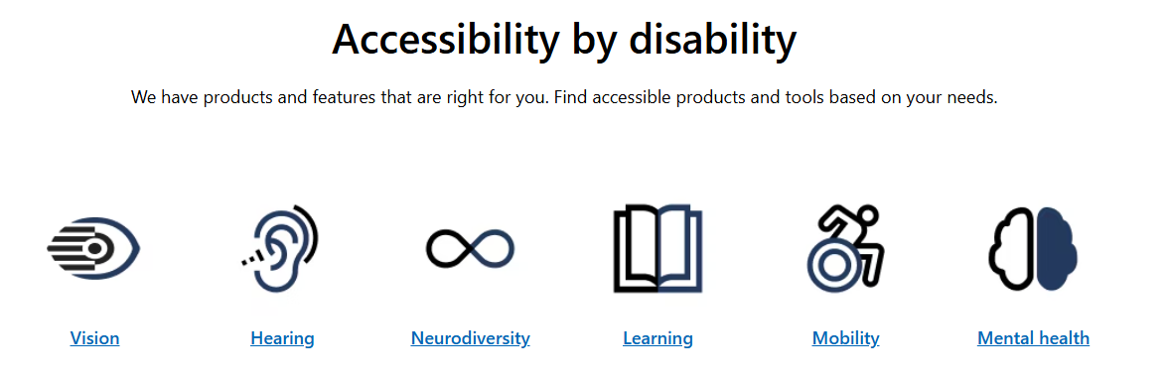
Accessibility & Gen AI
Microsoft wants to provide the best possible experience for all customers. Creating accessible, inclusive products is one of the main foundations of the development process.
Each and every person – no matter if facing disabilities or not - benefits from accessibility features.
Also Microsoft 365 Copilot Chat contains capabilities to support everyone to achieve more for example by making it accessible with a Screenreader.
A list of the constantly growing accessibility features can be found following this external link
The Microsoft Accessibility help & learning hub can be accessed following this external link
You can also get support from the disability answer desk following this external link
Or ask Microsofts accessibility AI tool clicking this external link
Source: Microsoft Disability Answer Desk Support | Microsoft Accessibility
If you are interested in how Gen AI helps disabled colleagues at Microsoft, follow this external link to a short Youtube series.
Notes:
Accessibility & Gen AI
Microsoft wants to provide the best possible experience for all customers. Creating accessible, inclusive products is one of the main foundations of the development process.
As well as other office products, also Microsoft 365 Copilot Chat contains capabilities to support everyone to achieve more for example by making it accessible with Screenreader.
A list of the constantly growing accessibility features can be found following this external link
The Microsoft Accessibility help & learning hub can be accessed following this external link
You can also get support from the disability answer desk following this external link
Or ask Microsofts accessibility AI tool clicking this external link
To continue, click next

Slide 9

Before we start
When using Generative AI within your work environment, be sure to stick with these best practices to stay safe and secure.
Only use company provided solutions
Especially free-to-use consumer services often don’t comply with regulatory and organizational requirements
Only share as much data as needed to do the job
Don’t share personal data not needed to perform the action
Keep organizational data’s protection, don’t override or bypass
Following these habits makes sure to keep your personal as well as organizational data protected.
!
Notes:
Before we start
When using Generative AI within your work environment, be sure to stick with these best practices to stay safe and secure.
Only use company provided solutions
Especially free-to-use consumer services often don’t comply with regulatory and organizational requirements
Only share as much data as needed to do the job
Don’t share personal data not needed to perform the action
Keep organizational data’s protection, don’t override or bypass
Following these habits makes sure to keep your personal as well as organizational data protected.
To continue, click next

Slide 10

What Gen AI Can Do for you
Imagine Microsoft 365 Copilot Chat as a smart assistant that can simplify your daily routines by helping you with various tasks and make your life a bit easier. Here are some everyday examples of how you might use it:
Write creative content such as composing e-mails, generating blog posts or brainstorming ideas
Organize and plan, for example your next business trip, the companies next event or just get help in prioritizing your tasks
Get personal assistance by answering questions, providing recommondations or automating tasks
Curious? Then let’s get started with Microsoft 365 Copilot Chat.
Source: Microsoft What is AI? - Training | Microsoft Learn
Notes:
What Gen AI Can Do for you
Imagine Microsoft 365 Copilot Chat as a smart assistant that can simplify your daily routines by helping you with various tasks and make your life a bit easier. Here are some everyday examples of how you might use it:
Write creative content such as composing e-mails, generating blog posts or brainstorming ideas
Organize and plan, for example your next business trip, the companies next event or just get help in prioritizing your tasks
Get personal assistance by answering questions, providing recommondations or automating tasks
To continue, click next

Slide 11
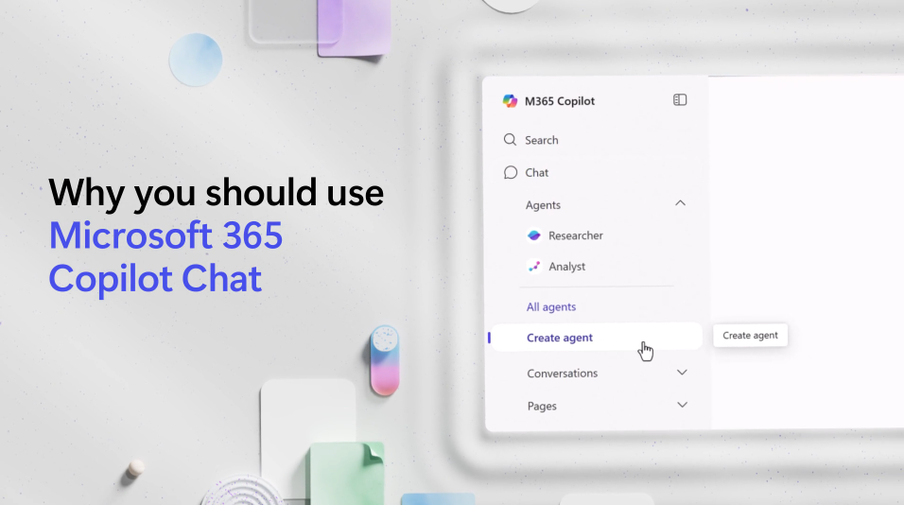
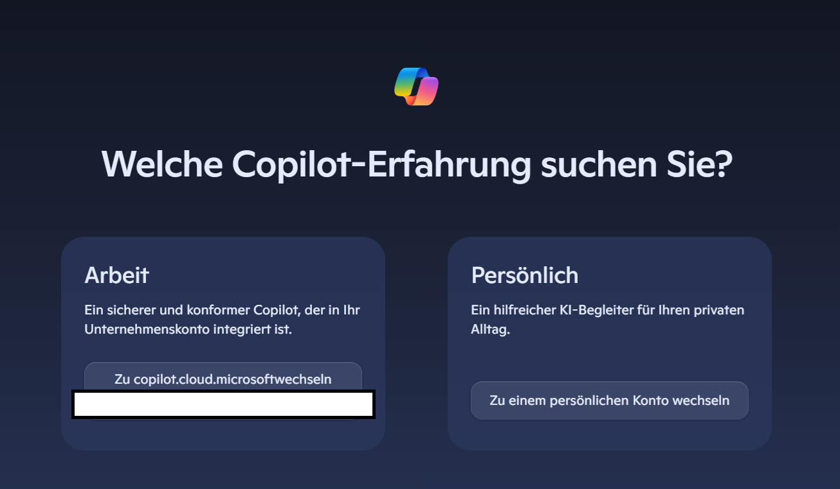
Get started with copilot chat
Microsoft 365 Copilot Chat is your secure AI chat, grounded in the web and powered by the latest models
It includes standard access to capabilities like file upload, image generation, and models (like GPT-5) whilst the paid Copilot license provides priority access and work data grounding
It is safe to use as it respects your organizations' IT controls, enterprise data protection and agent management
To get started, open the app
Or click the link / open your browser and navigate to https://m365.cloud.microsoft/chat/
Make sure you are signed in with your organisations’ credentials to be safe and secure, protected by enterprise security features
Source: Microsoft What is AI? - Training | Microsoft Learn
Notes:
Get started with copilot chat
Microsoft 365 Copilot Chat is your secure AI chat, grounded in the web and powered by the latest models.
It includes standard access to capabilities like file upload, image generation, and models (like GPT-5) whilst the paid Copilot license provides priority access and work data grounding
It is safe to use as it respects your organizations' IT controls, enterprise data protection and agent management
To get started, open the app
Or click the link / open your browser and navigate to https://m365.cloud.microsoft/chat/
Make sure you are signed in with your organisations’ credentials to be safe and secure, protected by enterprise security features
To continue, click next

Slide 12
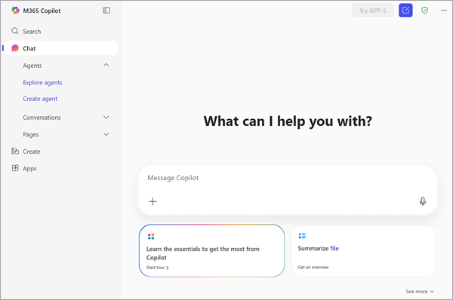


Overview of copilot chat
You made it! When Microsoft 365 Copilot Chat opens, no matter if in the app, the browser or Teams, the look & feel always stays the same
On the upper right, a green shield symbol signalizes that you are logged in with your organizations' identity and safe to use
Left of it is the “new conversation” button. Make sure to start a new conversation whenever the foundational topic changes
On the left side there is the app or agent pane, giving you fast access to additional functionality
Source: Microsoft Welcome to the Microsoft 365 Copilot app - Microsoft Support
Notes:
Overview of copilot chat
You made it! When Microsoft 365 Copilot Chat opens, no matter if in the app, the browser or Teams, the look & feel always stays the same
On the upper right, a green shield symbol signalizes that you are logged in with your organizations' identity and safe to use
Left of it is the “new conversation” button. Make sure to start a new conversation whenever the foundational topic changes
On the left side there is the app or agent pane, giving you fast access to additional functionality
To continue, click next

Slide 13
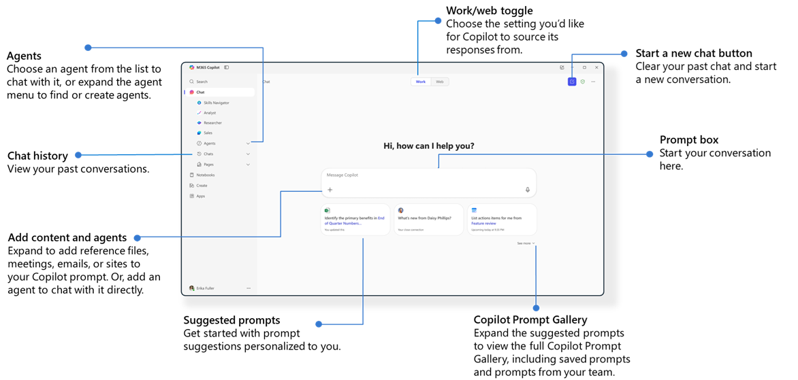
Closer view on copilot chat
Source: Microsoft Utilize Microsoft 365 Copilot Chat - Training | Microsoft Learn
Notes:
Closer view on copilot chat
As you might have noticed, there is a lot more to explore on the screen. This picture gives you an overview of the most important and always present functionalities when opening Microsoft 365 Copilot Chat. We will dive deeper into the specifics later on, for the moment just explore and make sure to save this site as reference for the future.
When you are ready - click next to continue

Slide 14
First interaction with copilot chat
The central point of interaction is right in the middle, stating “Message Copilot”.
The + symbol enables you to upload data, pictures and documents you would like Copilot to interact with
The microphone symbol gives you the possibility to interact via voice, for example to dictate your instructions
Now, enter your first instruction, maybe starting with “Tell me how you can help me in my day-to-day work” and click the send button.
Copilot Chat starts working on generating an answer for you right away. Have some turns in interacting with Copilot.
Source: Microsoft Welcome to the Microsoft 365 Copilot app - Microsoft Support
Notes:
First interaction with copilot chat
The central point of interaction is right in the middle, stating “Message Copilot”.
The + symbol enables you to upload data, pictures and documents you would like Copilot to interact with
The microphone symbol gives you the possibility to interact via voice, for example to dictate your instructions
Now, enter your first instruction, maybe starting with “Tell me how you can help me in my day-to-day work” and click the send button.
Copilot Chat starts working on generating an answer for you right away. Have some turns in interacting with Copilot.
To continue, click next

Slide 15
Be precise, be specific
Hopefully your first turns with the first prompt have been fun and engaging! But did they also provide the result you would have expected?
Your instructions – called prompts - heavily influence the result provided
Imagine Copilot Chat as an assistant having the first day – knowing it all, but you needing context to perform
“Tell me how you can help me in my day-to-day work” leaves a lot of room for interpretation or guessing, let’s see how we can make this more specific.
Be precise in what exactly you need
Be specific in what could influence the result
Give as much context as possible
Tell Copilot which role it needs to work in with
Let’s have a try on improving our first prompt.
Notes:
Be precise, be specific
Hopefully your first turns with the first prompt have been fun and engaging! But did they also provide the result you would have expected?
Your instructions – called prompts - heavily influence the result provided
Imagine Copilot Chat as an assistant having the first day – knowing it all, but you needing context to perform
“Tell me how you can help me in my day-to-day work” leaves a lot of room for interpretation or guessing, let’s see how we can make this more specific.
Be precise in what exactly you need
Be specific in what could influence the result
Give as much context as possible
Tell Copilot which role it needs to work in with
Let’s have a try on improving our first prompt.
To continue, click next

Slide 16
Improved Promts Improve Results
Try in iterations, create a new conversations every time to see how the first result provided changes through optimizing your prompt. In every iteration, add new information to the prompt such as
your role
the industry you are working in
the department you are working in
the environment you are working within (e.g. globally)
a challenge you are facing
the role Copilot should play in this
After some iterations you could be ending up in a prompt like: “I am a data scientist in the sales department of a globally acting company. I am under timely pressure to deliver my results presenting sales data to the country leads. Tell me how you as my assistant can help me in my day-to-day work”
Does the result after reshaping the prompt make the grade?
If you are interested in learning more about Prompt ingredients and best practices for refinement, follow this external link to learn more.
Notes:
Improved Promts Improve Results
Try in iterations, create a new conversations every time to see how the first result provided changes through optimizing your prompt. In every iteration, add new information to the prompt such as
your role
the industry you are working in
the department you are working in
the environment you are working within (e.g. globally)
a challenge you are facing
The role Copilot should play in this
Does the result after reshaping the prompt make the grade?
If you are interested in learning more about Prompt ingredients and best practices for refinement, follow this external link to learn more.
To continue, click next

Slide 17
Module 1 recap
You made it through Module 1 - Explore! We hope you enjoyed the time and are more than curious to continue. Let’s shortly recap what we went through
Use AI in a responsible way
Only use company provided AI solutions to keep data secure
Discover by trial and error how generative AI can help you
Make sure to provide all needed information to do the job – the better your instructions are, the better the result will be
Connect and share your experiences and best practices with colleagues, you’ll see how one can accelerate the other
If you just can’t stop learning, use the additional links provided on the respective sites. And on the next page you will find additional resources to deepen your knowledge.
🎉
Notes:
Module 1 Recap
You made it through Module 1 - Explore! We hope you enjoyed the time and are more than curious to continue. Let’s shortly recap what we went through
Use AI in a responsible way
Only use company provided AI solutions to keep data secure
Discover by trial and error how generative AI can help you
Make sure to provide all needed information to do the job – the better your instructions are, the better the result will be
Connect and share your experiences and best practices with colleagues, you’ll see how one can accelerate the other
If you just can’t stop learning, use the additional links provided on the respective sites. And on the next page you will find additional resources to deepen your knowledge.
To continue, click next

Slide 18
Module 1 additional resources
As a bonus, we want you to know these valuable resources to further rocket-fuel your journey with Microsoft 365 Copilot Chat at work (external links):
Copilot Chat Prompt examples in weekly challenges
Additional Prompting Guidance
Copilot Prompt Gallery for inspiration
Microsoft help and learning center
Frequently asked questions about Copilot Chat
See you in the next module “Endavour” to continue the journey.
📖
Notes:
Module 1 additional resources
As a bonus, we want to provide you these valuable resources to further rocket-fuel your journey with Microsoft 365 Copilot Chat at work (external links):
Copilot Chat Prompt examples in weekly challenges
Additional Prompting Guidance
Copilot Prompt Gallery for inspiration
Microsoft help and learning center
Frequently asked questions about Copilot Chat
See you in the next module “Endavour” to continue the journey.
To continue, click next

Slide 19
Module 2 - Endavour
Microsoft 365 Copilot Chat in Edge
The M365 Copilot Chat App
Talk to Copilot
Create
How to expand your skills
Notes:
Welcome to Module 2.
In the next minutes we want to explore further possibilities of using Microsoft 365 Copilot Chat. In addition to the app, there are several places where it integrates smoothly in your working day – making it easy to access and helpful right within your working context.
Click next to continue.

Slide 20
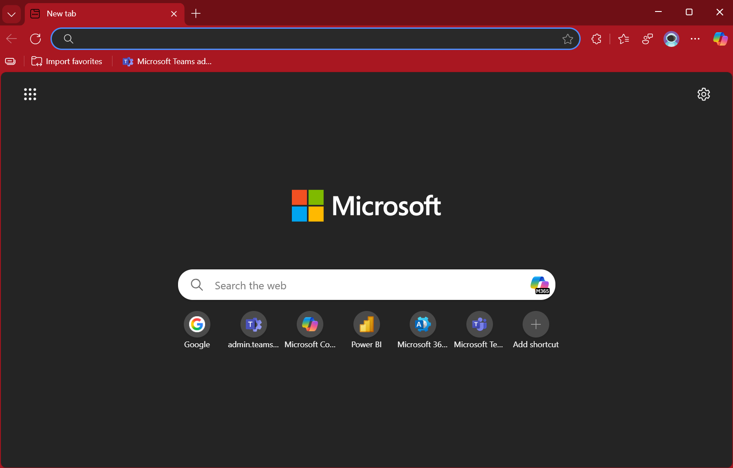
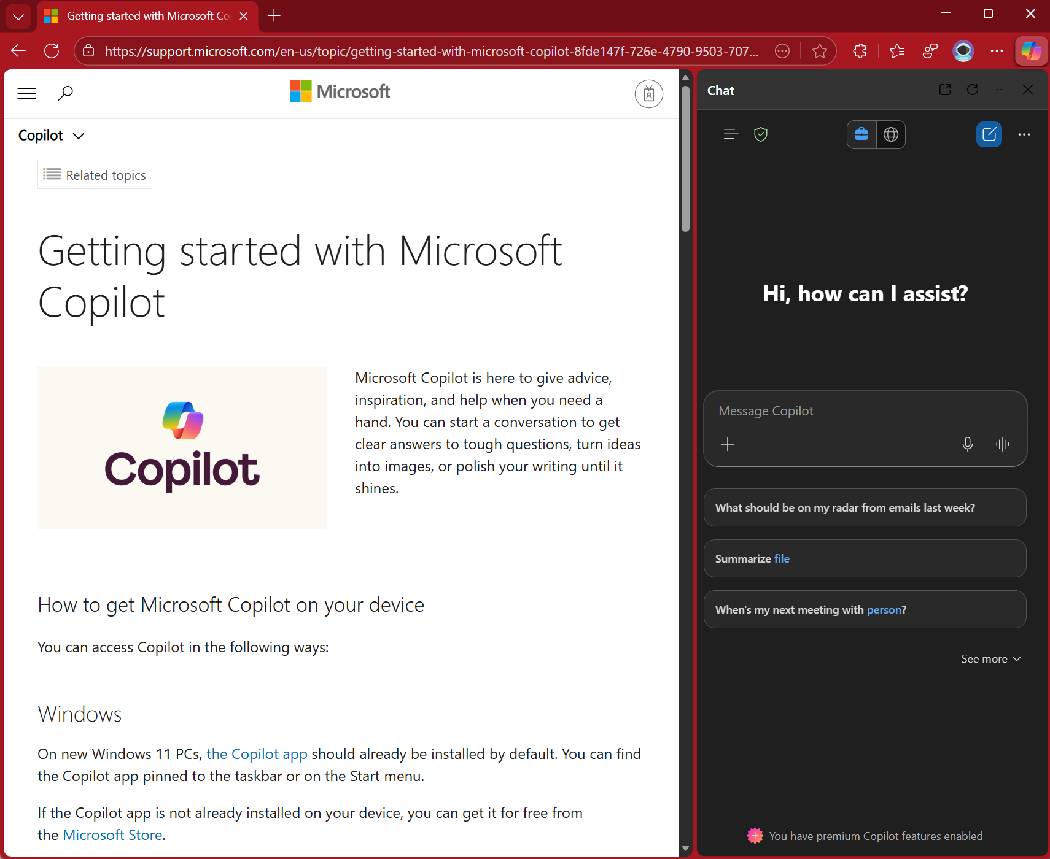
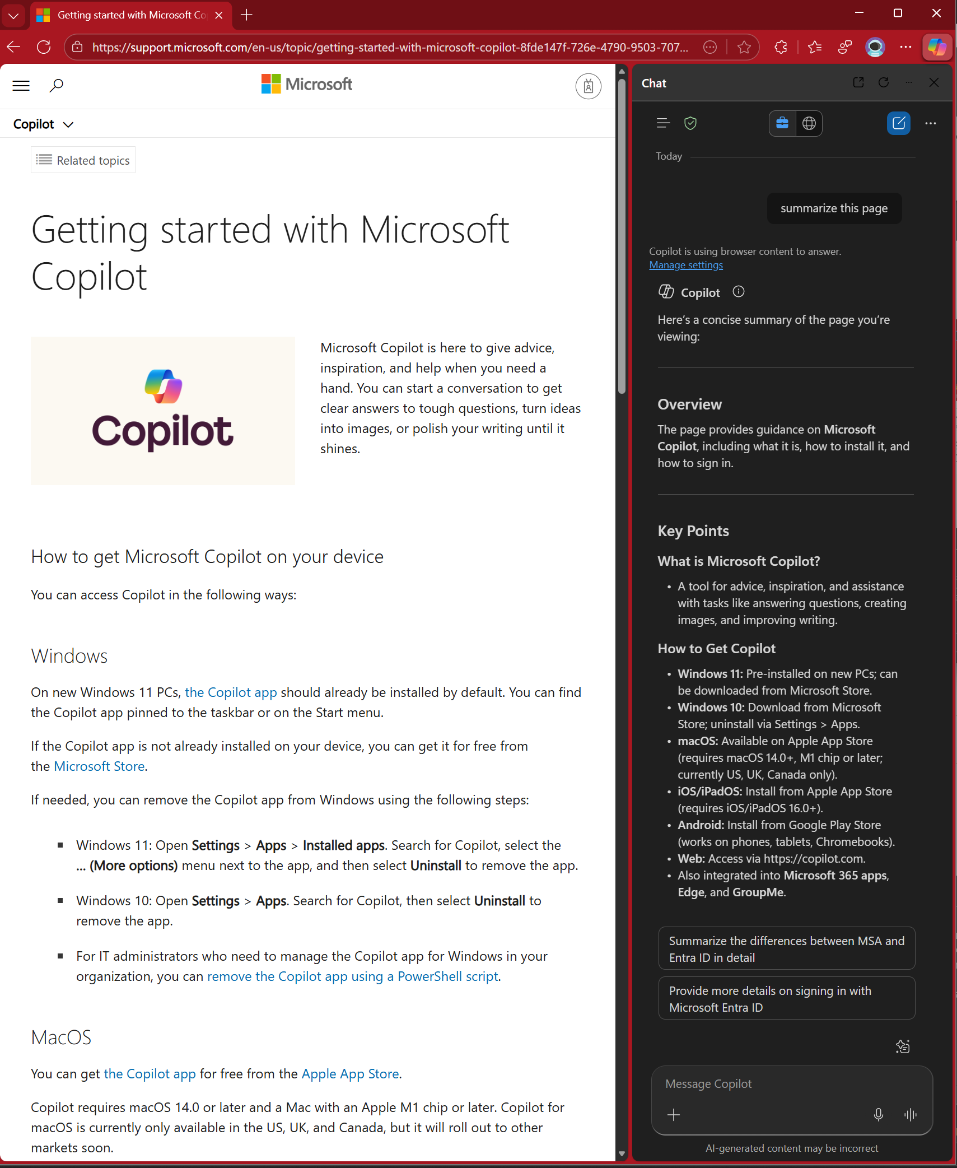
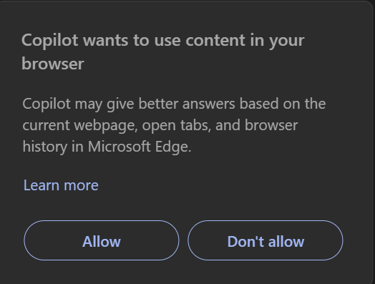
Copilot in edge
In the last module we have been leveraging Microsoft 365 Copilot Chat within the browser by heading to the address https://m365.cloud.microsoft/
But wait – what if we are browsing around and need a long page to be summarized or a table to be created from the content currently displayed?
Find Copilot in the upper right corner of your edge browser and click on the symbol
You might be prompted if you allow that Copilot accesses the information in your browser
Now ask a question, e.g. “summarize the content of this page”
You’ll get your answer right away, ask detailed questions or get the result shaped in another way. Try it!
Notes:
Copilot in edge
In the last module we have been leveraging Microsoft 365 Copilot Chat within the browser by heading to the address https://m365.cloud.microsoft/
But wait – what if we are browsing around and need a long page to be summarized or a table to be created from the content currently displayed?
Find Copilot in the upper right corner of your edge browser and click on the symbol
You might be prompted if you allow that Copilot accesses the information in your browser
Now ask a question, e.g. “summarize the content of this page”
You’ll get your answer right away, ask detailed questions or get the result shaped in another way. Try it!
To continue click next

Slide 21
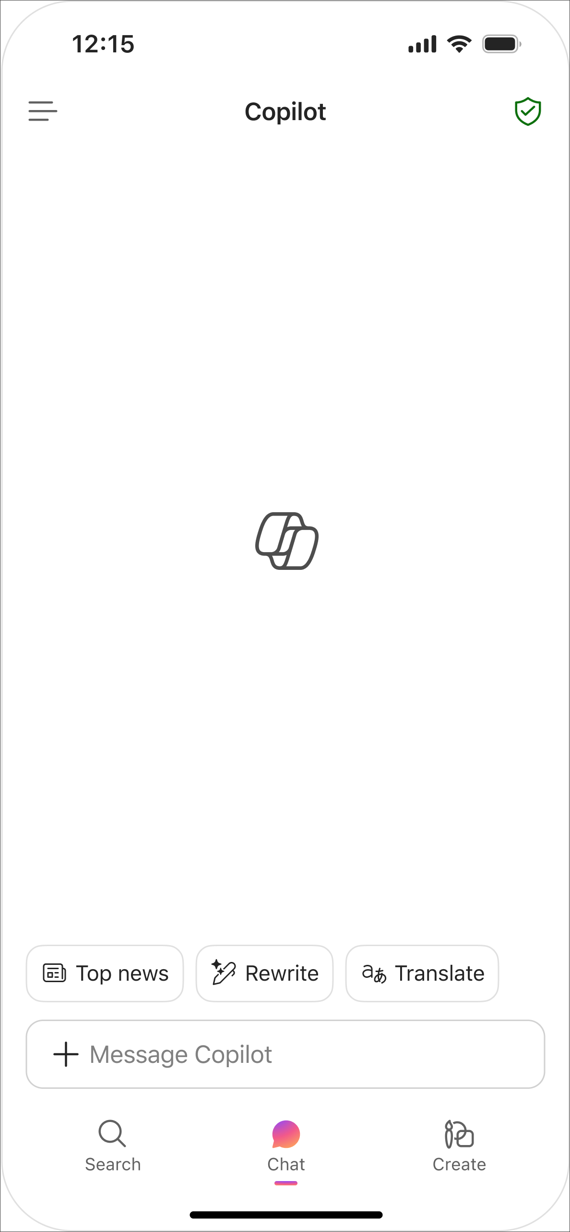

The M365 Copilot app & mobile
Ok, so we used the browser to access the web version and we saw it in action integrated in Edge. But Copilot Chat is where you are, no need to open the browser to get going.
Look at the taskbar of your device, is there a M365 Copilot Chat logo? If not – just download from the Microsoft store, or the version for Mac
Make sure to also have it installed on your mobile device. Download it for iOS or Android
You will have the same functionality as on your desktop – and all interactions are synced – so start on the go and continue on your desk.
Have a try by clicking the menu on the upper left on mobile, then click conversations – it‘s all there!
Pssst….if you hit the Windows key + C on Windows it instantly opens up the app
Source: Microsoft Get started with the Microsoft 365 Copilot mobile app
Notes:
The M365 Copilot app and mobile
Ok, so we used the browser to access the web version and we saw it in action integrated in Edge. But, as promised, Microsoft 365 Copilot Chat is where you are, no need to open the browser to get going.
Look at the taskbar of your Windows device, is there a M365 Copilot Chat logo? If not – just download the app from the store, it’s free. And yes, there also is a version for Mac
Make sure to also have it installed on your mobile device. Download it for iOS or Android
You will have the same functionality as using it on your desktop – and by the way, all interactions are synced – so start on the go and continue on your desk.
Have a try by clicking the menu on the upper left on mobile, then click conversations – it‘s all there!
Pssst….if you hit the Windows key + C on Winsows it instantly opens up the app
To continue, click next

Slide 22
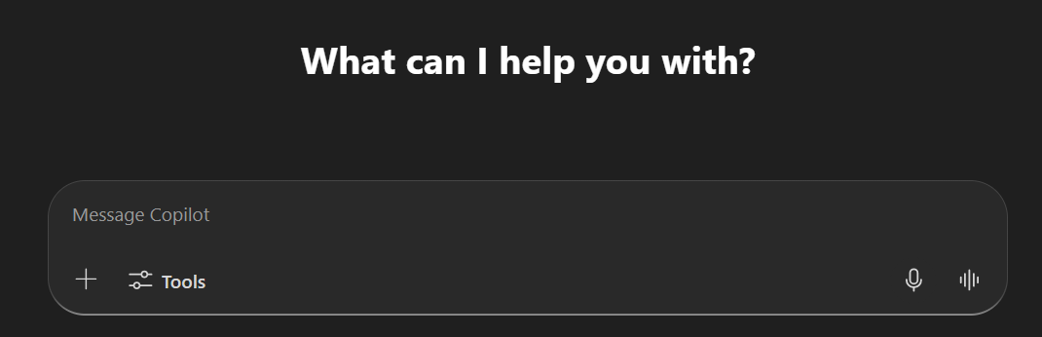
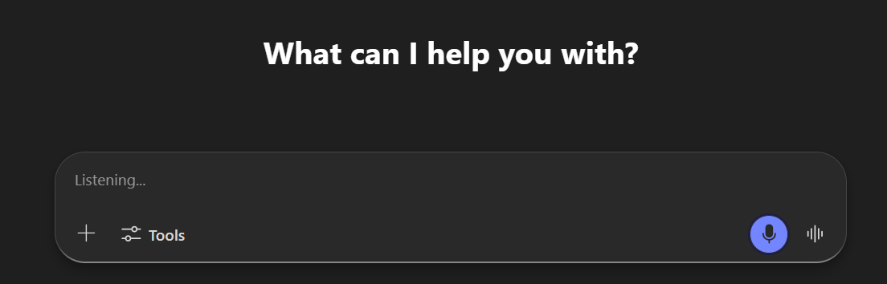
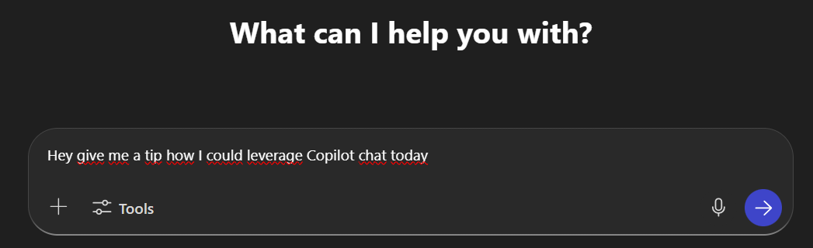

Talk to copilot chat
Tired of hitting the keys? Or just not able to use the keyboard right now? Help is on the way!
You can use your voice to let Microsoft 365 Copilot Chat know what you need
Just click the microphone symbol in the prompt window
Copilot is listening carefully, writing down your inputs after a bit so that you can be sure it understands what you are saying
All said? Then hit the send button and Copilot Chat acts on your dictated prompt as it would be if you had written it
No capacity to read through the answer? No problem, click „read aloud“ the bottom and just listen to it
If you are interested in diving deeper, follow this external link.
Notes:
Talk to copilot chat
Tired of hitting the keys? Or just not able to use the keyboard right now? Helps is on the way!
You can use your voice to let let Microsoft 365 Copilot Chat know what you need
Just click the microphone symbol in the prompt window
Copilot is listening carefully, writing down your inputs after a bit so that you can be sure it understands what you are saying
All said? Then hit the send button and Copilot Chat acts on your dictated prompt as it would be if you had written it
No capacity to read through the answer? No problem, click „read aloud“ the bottom and just listen to it
To continue, click next

Slide 23
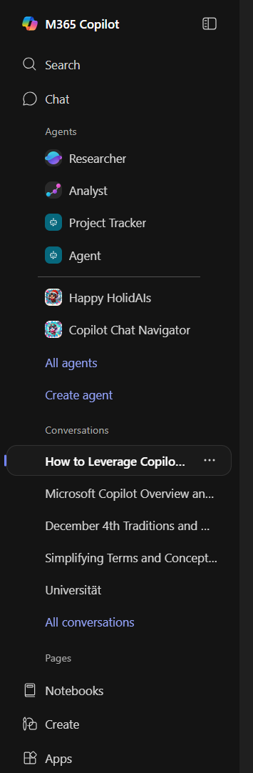
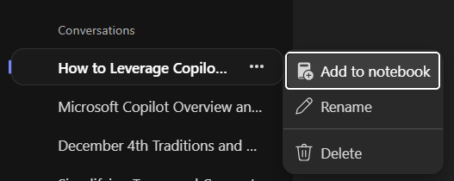
Revisit chat history
We’ve been playing around quite some time now. Do you still remember the answer on the first prompt? Well, Copilot does!
In the left menu bar you will find a lot of possibilities
One of it: the conversation history
Just click on it and a list of recent conversations pops out
With a click on the ellipses you can also
rename the conversation
save it for later (we’ll get to this in a bit)
or delete it
If you would like to delete all of your conversation history, follow this external link.
You see – nothing get‘s lost, except you want it to.
Notes:
Revisit chat history
We’ve been playing around quite some time now. Do you still remember the answer on the first prompt? Well, Copilot does!
In the left menu bar you will find a lot of possibilities
One of it: the conversation history
Just click on it and a list of recent conversations pops out
With a click on the ellipses you can also
rename the conversation
save it for later (we’ll get to this in a bit)
or delete it
If you would like to delete all of your conversation history, follow this external link.
You see – nothing get‘s lost, except you want it to.
To continue, click next

Slide 24
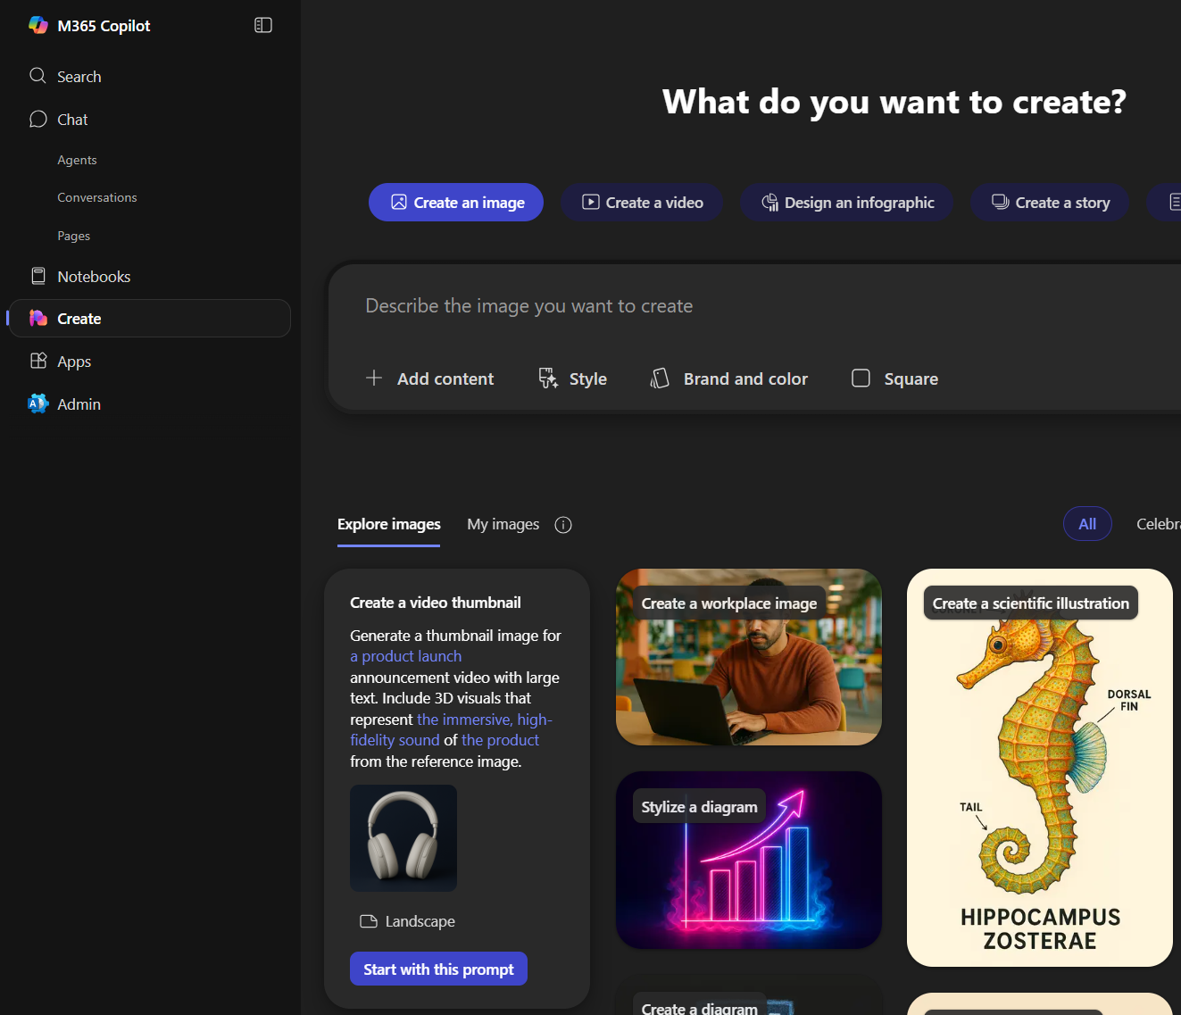
Create
Is it only me, or is it time to bring some fun in here? After all of that clicking and learning – let’s relax our brain and let Copilot work for us.
Copilot Chat comes with a lot of fun – and maybe you also have been in the situation to just not having the right image for the current context
Either just type into the prompt window what you need, such as „create an image of a flying penguine heading to thr next business meeting. make it photo realistic. it flies over frankfurt am main.“
Or you use the „create“ option on the left menu bar. It comes with a lot of inspiration and help to get to your results
No matter if business diagram, a photo, a poster or a comic – possibilities are endless
but always remember: be specific & precise for best results
If you are interested in diving deeper into the possibilities to create, follow this external link.
Notes:
Create
Is it only me, or is it time to bring some fun in here? After all of that clicking and learning – let’s relax our brain and let Copilot work for us.
Copilot Chat comes with a lot of fun – and maybe you also have been in the situation to just not having the right image for the current context
Either just type into the prompt window what you need, such as „create an image of a flying penguine heading to thr next business meeting. make it photo realistic. it flies over frankfurt am main.“
Or you use the „create“ option on the left menu bar. It comes with a lot of inspiration and help to get to your results
No matter if business diagram, a photo, a poster or a comic – possibilities are endless
but always remember: be specific & precise for best results
If you are interested in diving deeper into the possibilities to create, follow this external link.
To continue and get back to business, click next

Slide 25
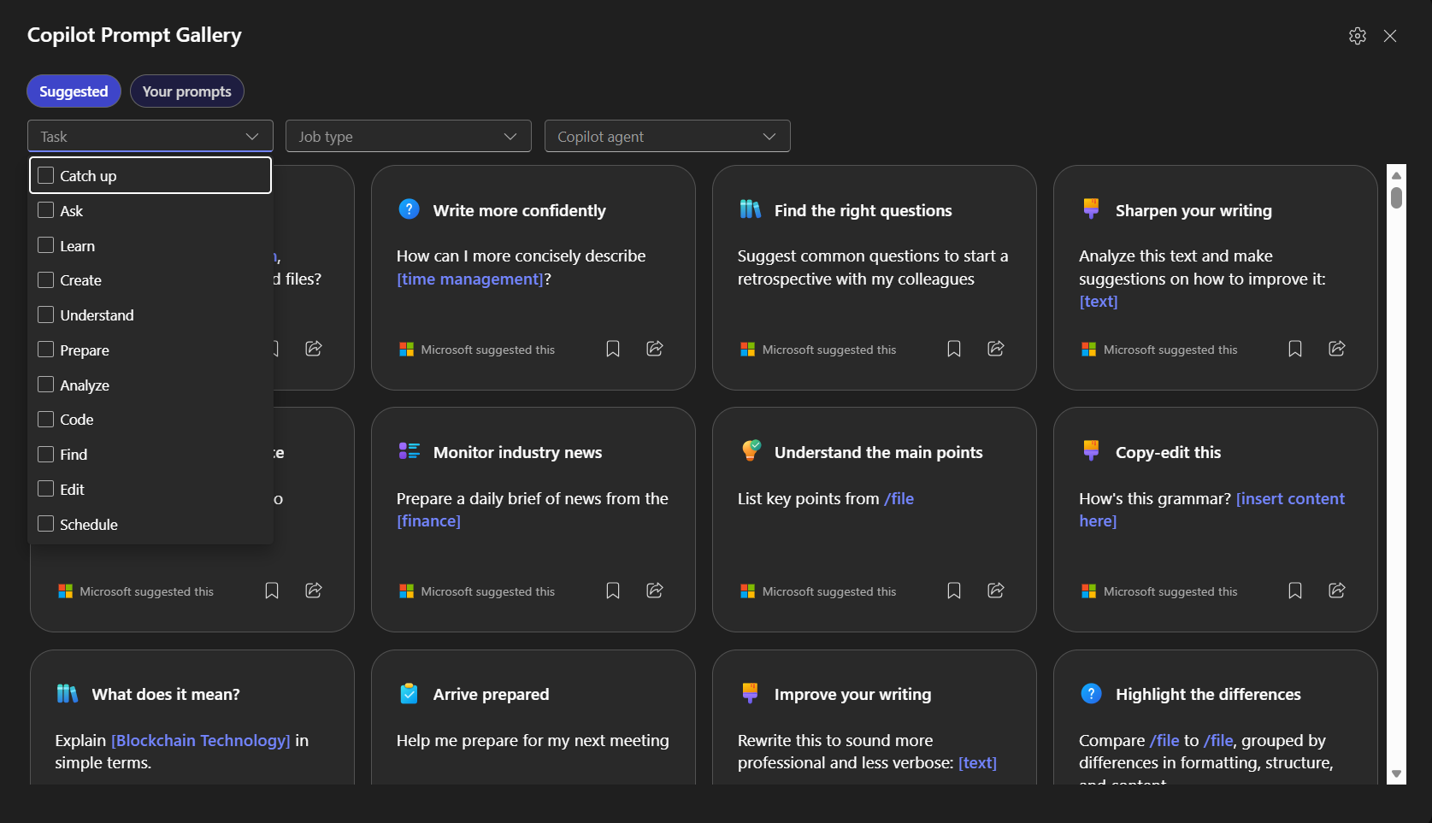
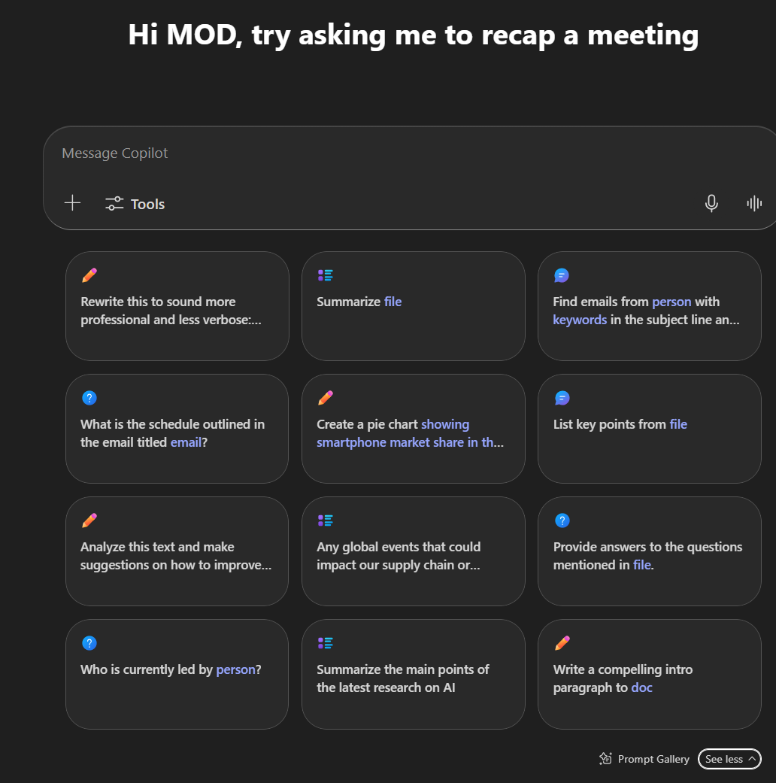
Prompt Gallery
Now that was fun! So let’s restart slowly by getting inspiration and best practices. The Prompt Gallery contains loads of examples how you could best leverage Microsoft 365 Copilot Chat.
Filter by task you need to achieve
Filter by role you are having
Find your saved prompts
Find company wide shared prompts
Access the Prompt Gallery through this link
Or at any time within the Copilot Chat at the bottom of the prompting window
Have a try!
Notes:
Prompt Gallery
Now that was fun! So let’s restart slowly by getting inspiraton and best practices. The Prompt Gallery contains loads of examples how you could best leverage Microsoft 365 Copilot Chat.
Filter by task you need to achieve
Filter by role you are having
Find your saved prompts
Find company wide shared prompts
Access the Prompt Gallery through this link
Or at any time within the Copilot Chat at the bottom of the prompting window
Have a try!
To continue, click next

Slide 26
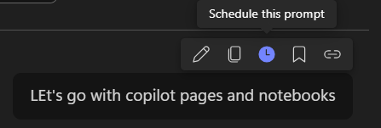
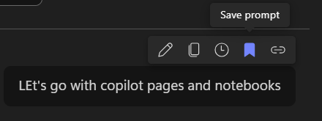
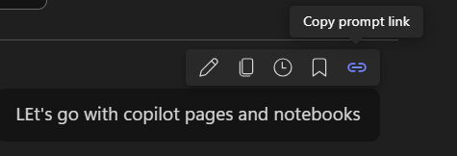

prompt Handling and sharing
Wait a minute – saved Prompts in the Prompt Gallery? Let’s see what else we can do with a Prompt
Hover over the prompt to see the context menu
Schedule the prompt you just entered for additional runs at a later time
Save the prompt you just entered to use it through the Prompt Gallery later on
Directly share your prompt with others so that they can use it on their own
If you like the answer to your prompt – you can copy and share it. Just use the context menu on the bottom of the response.
Notes:
prompt Handling and sharing
Hover over the prompt to see the context menu
Schedule the prompt you just entered for additional runs at a later time
Save the prompt you just entered to use it through the Prompt Gallery later on
Directly share your prompt with others so that they can use it on their own
If you like the answer to your prompt – you can copy and share it. Just use the context menu on the bottom of the response.
To continue, click next

Slide 27
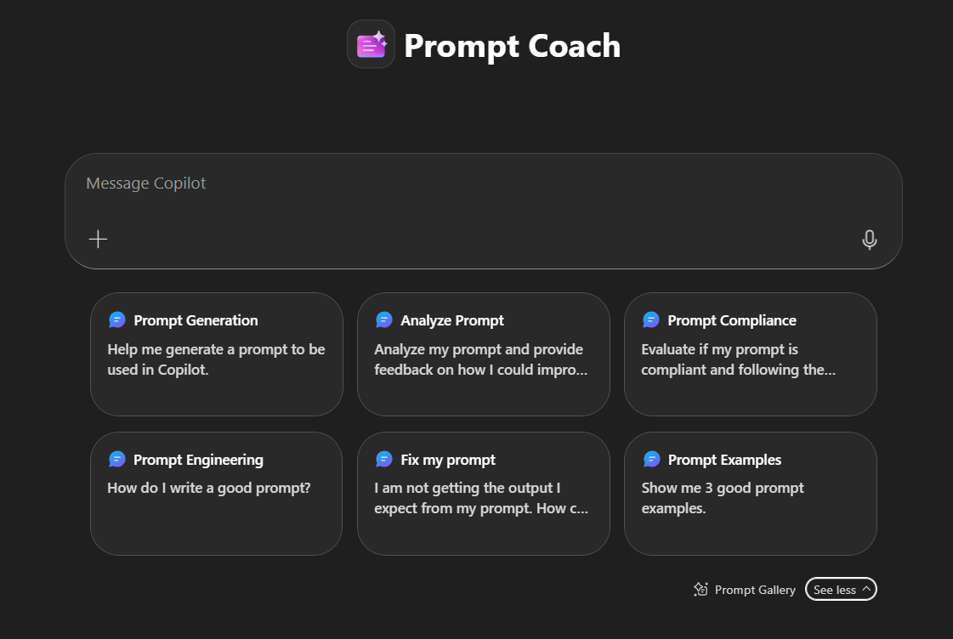
Prompt coach
Now that we know how important prompting skills are to get fast and accurate results. Training is key – and your coach is right at your side!
The Microsoft developed Prompt Coach Agent helps you train and refine your prompting skills
Detailed prompt analysis
Helps to ensure clarity and optimal phrasing
Provides concrete prompt examples, with step-by-step explanations
Install prompt Coach by clicking this link or searching for it via „All Agents“ in the left menu bar
Try it!
If you are interested in learning more about Prompt Coach, follow this external link.
Notes:
Prompt coach
Now that we know how important prompting skills are to get fast and accurate results. Training is key – and your coach is right at your side!
The Microsoft developed Prompt Coach Agent helps you train and refine your prompting skills
Detailed prompt analysis
Helps to ensure clarity and optimal phrasing
Provides concrete prompt examples, with step-by-step explanations
Install prompt Coach by clicking this link or searching for it via „All Agents“ in the left menu bar
Try it!
If you are interested in learning more about Prompt Coach, follow this external link.
To continue click next

Slide 28
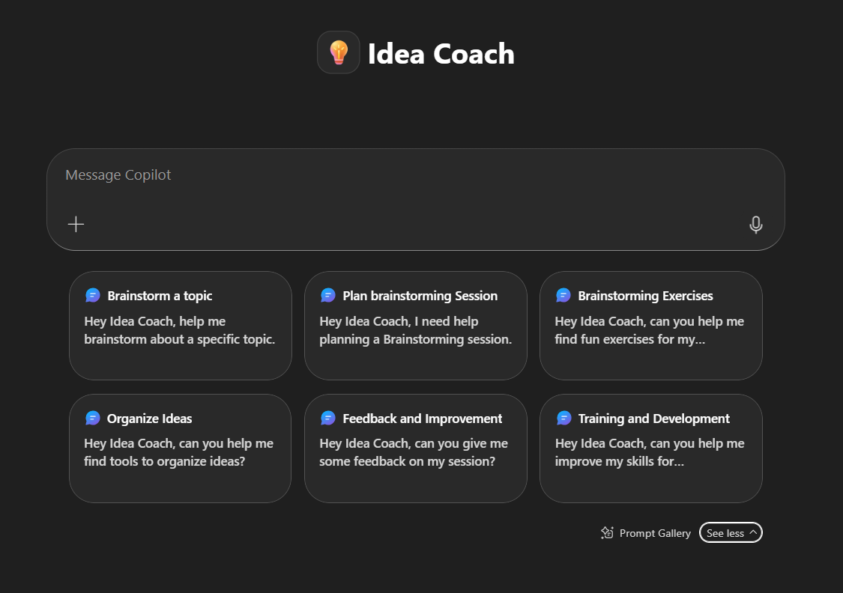
Idea coach
Ok, prompts aside – now it’s about content! Do you know these times when ideas are needed, but don’t come along easy? This is where Idea Coach enters the stage
Provide AI-driven brainstorming through a guided dialogue and creative exercises to help users effectively develop and refine ideas
Customize agendas and exercises for brainstorming sessions based on user input to ensure engaging and productive brainstorming sessions
install Idea Coach by clicking this link or searching for it via „All Agents“ in the left menu bar
Let‘s get it on
If you are interested in learning more about Idea Coach, follow this external link.
Notes:
Idea coach
Ok, prompts aside – now it’s about content! Do you know these times when ideas are needed, but don’t come along easy? This is where Idea Coach enters the stage
Provide AI-driven brainstorming through a guided dialogue and creative exercises to help users effectively develop and refine ideas
Customize agendas and exercises for brainstorming sessions based on user input to ensure engaging and productive brainstorming sessions
install Idea Coach by clicking this link or searching for it via „All Agents“ in the left menu bar
Let‘s get it on
To continue, click next

Slide 29
Module 2 recap
You made it through Module 2 - Endavour! We hope you enjoyed the time and are more than curious to continue.
If you just can’t stop and want to deepen the topics, use the additional links provided on the respective sites.
As a bonus, we also want you to know these valuable resources to further accelerate your journey with Microsoft 365 Copilot Chat (external links):
Copilot Scenario Gallery – Best practices based on functional roles
Copilot Chat Prompt examples in weekly challenges
Additional Prompting Guidance
Microsoft help and learning center
Frequently asked questions about Copilot Chat
See you in the next module “Enrich” to continue the journey.
🎉
Notes:
Module 2 recap
You made it through Module 2 - Endavour! We hope you enjoyed the time and are more than curious to continue.
If you just can’t stop and want to deepen the topics, use the additional links provided on the respective sites.
As a bonus, we also want you to know these valuable resources to further accelerate your journey with Microsoft 365 Copilot Chat (external links):
Copilot Scenario Gallery – Best practices based on functional roles
Copilot Chat Prompt examples in weekly challenges
Additional Prompting Guidance
Microsoft help and learning center
Frequently asked questions about Copilot Chat
See you in the next module “Enrich” to continue the journey.
To continue, click next

Slide 30
Module 3 - Enrich
Draft or add content
Create – whatever you need
Visualize Data
Share your results
Copilot Pages
Notes:
Welcome to module 3 – enrich
In this module it is all about doing more. We are covering the topics:
Draft or add content
Create – whatever you need
Visualize Data
Share your results
Copilot Pages
Copilot Notebooks
To continue, click next

Slide 31
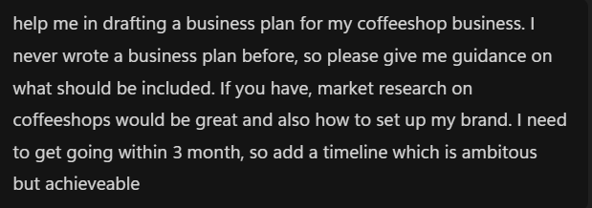
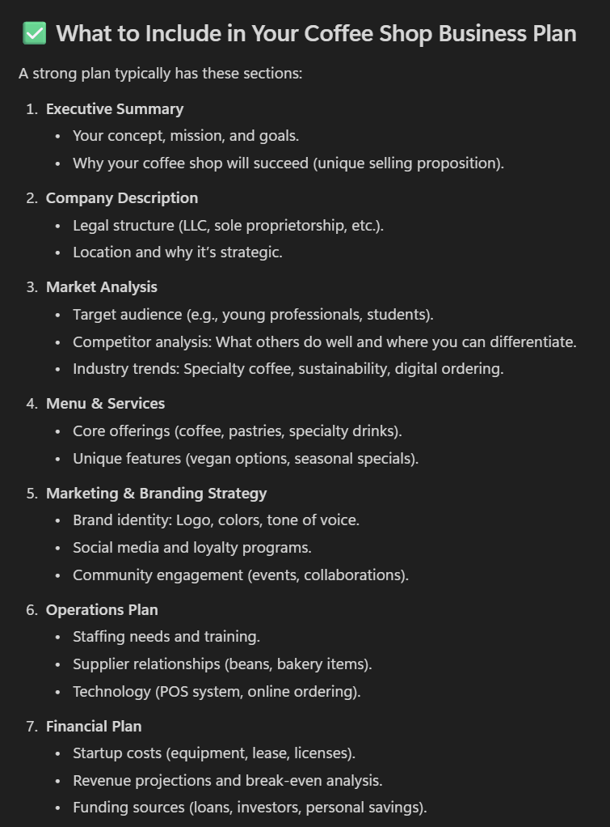
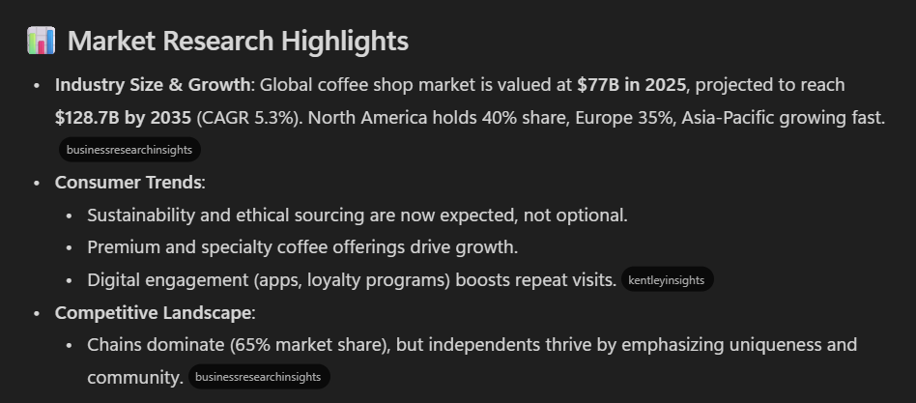
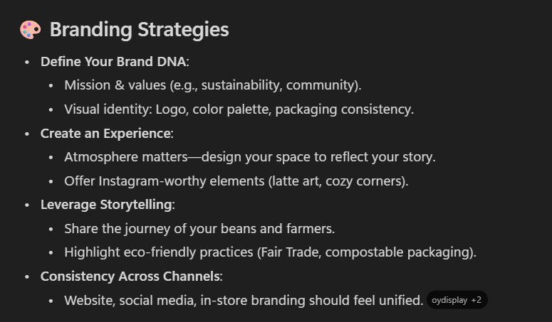
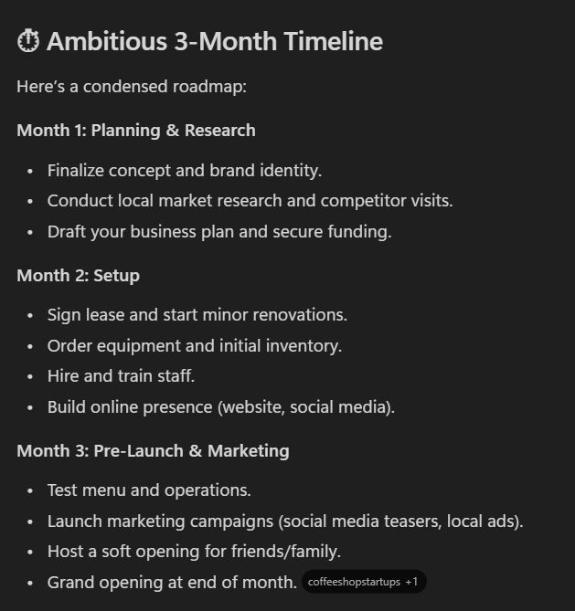
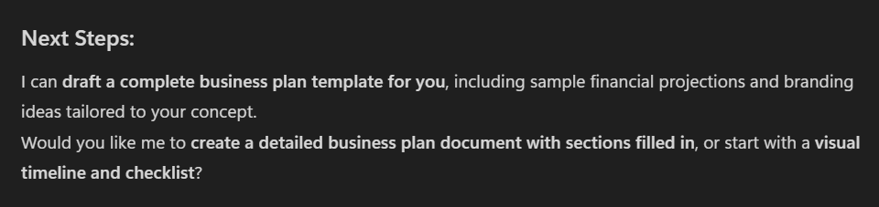
Draft Content
There are days where you just don’t find the right words. Or just don’t find the right impulse to start. Have a try with Microsoft 365 Copilot Chat!
No matter if you are thinking about a project, need to write a blueprint or set up something you never did before
Try giving Copilot Chat some input to work on it and ease your start into the topic
Hand over the topic and what you are going to achieve and you are good to go. As always: the more context the better, the more specific…you already know how it works
As you can see – Copilot Chat not only gives you an answer, but structures it well and also proposes next best steps.
Beginning something new has never been easier. Try it out!
Notes:
Draft Content
There are days where you just don’t find the right words. Or just don’t find the right impulse to start. Have a try with Microsoft 365 Copilot Chat!
No matter if you are thinking about a project, need to write a blueprint or set up something you never did before
Try giving Copilot Chat some input to work on it and ease your start into the topic
Hand over the topic and what you are going to achieve and you are good to go. As always: the more context the better, the more specific…you already know how it works
As you can see – Copilot Chat not only gives you an answer, but structures it well and also proposes next best steps.
Beginning something new has never been easier. Try it out!
To continue, click next

Slide 32
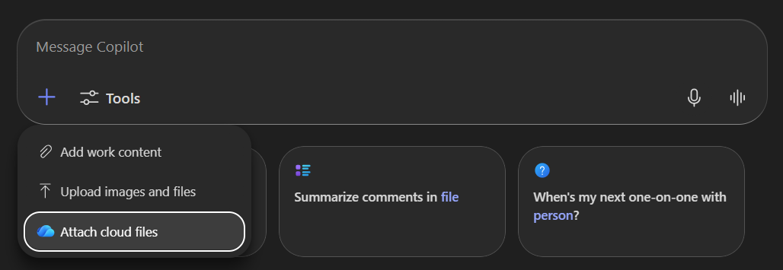
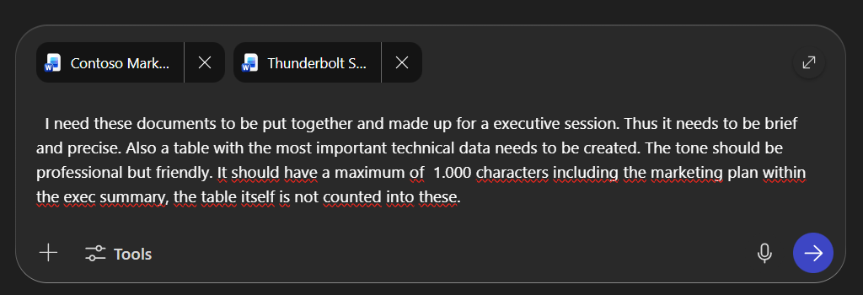
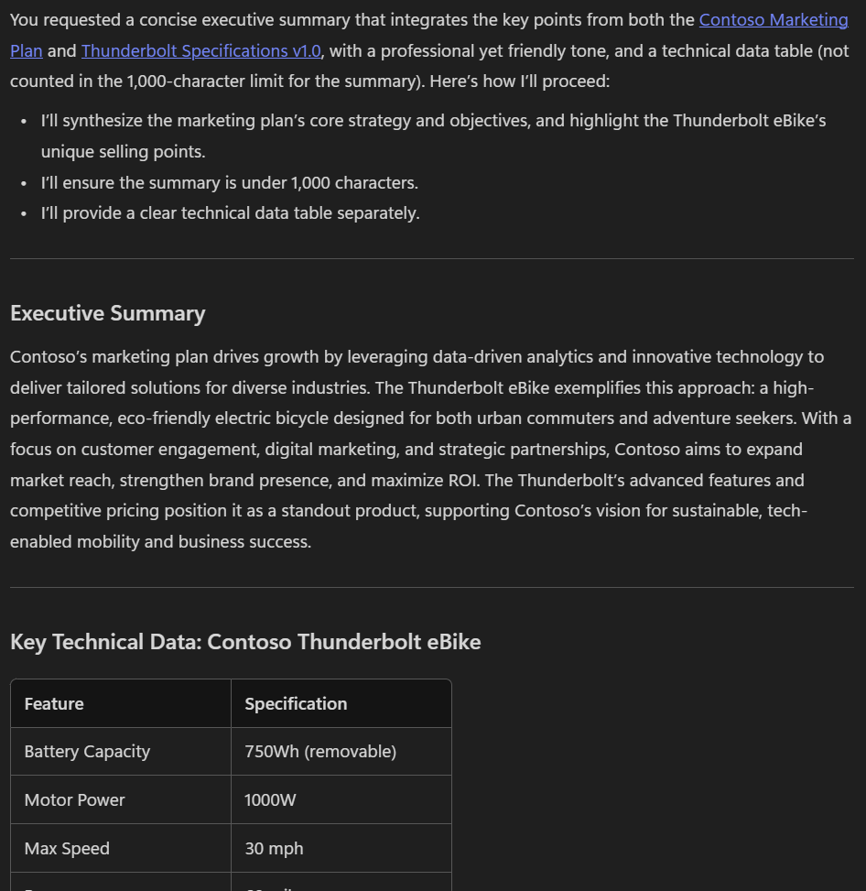
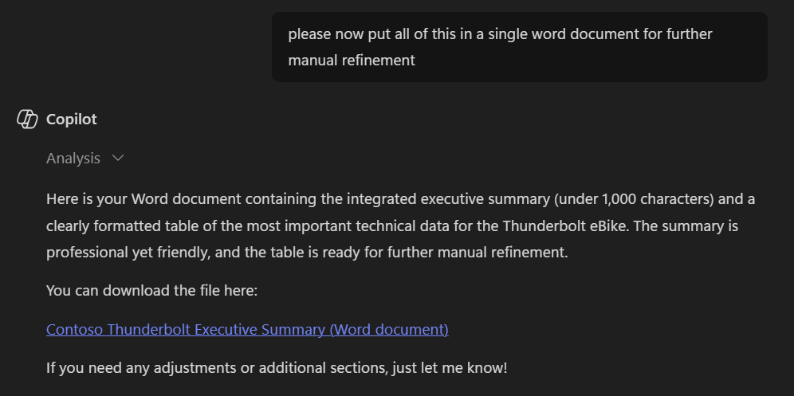
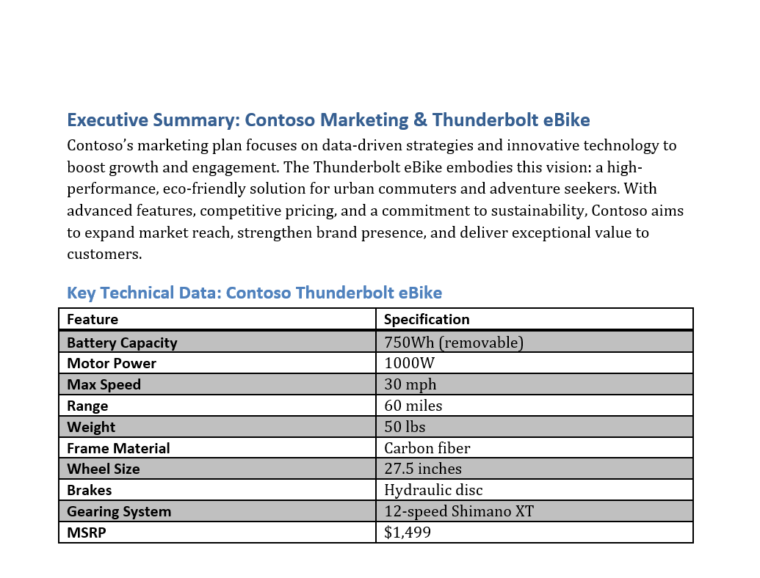
Add content
New scenario, similar challenge. Having some groundwork done yourself you want to tighten the content, focus on your stakeholder group and sharpen the message through easy to read tables.
Take your base document (also more than one document is possible) and upload it to Copilot Chat
Give context and tell Copilot what to do – after firing up the instructions, Copilot also summarizes what to do and gets on working
Work in iterations, refining the result step by step
At the end – let Copilot put it all together
I bet this is faster than doing it all on your own, isn‘t it?
Have a try and reflect on the outcomes
To learn more about adding content to your prompt, follow this external link.
Notes:
Add content
New scenario, similar challenge. Having some groundwork done yourself you want to tighten the content, focus on your stakeholder group and sharpen the message through easy to read tables.
Take your base document (also more than one document is possible) and upload it to Copilot Chat
Give context and tell Copilot what to do – after firing up the instructions, Copilot also summarizes what to do and gets on working
Work in iterations, refining the result step by step
At the end – let Copilot put it all together
I bet this is faster than doing it all on your own, isn‘t it?
Have a try and reflect on the outcomes
To continue, click next

Slide 33
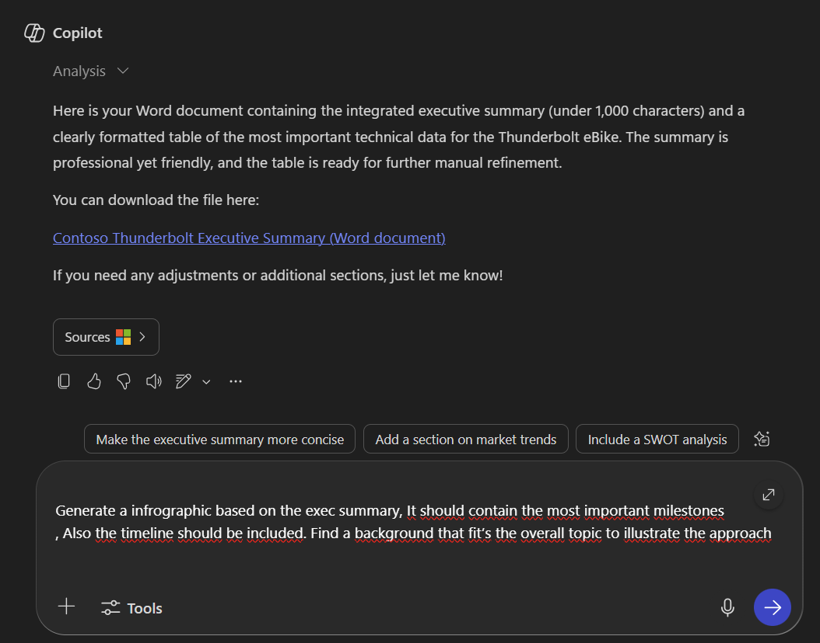
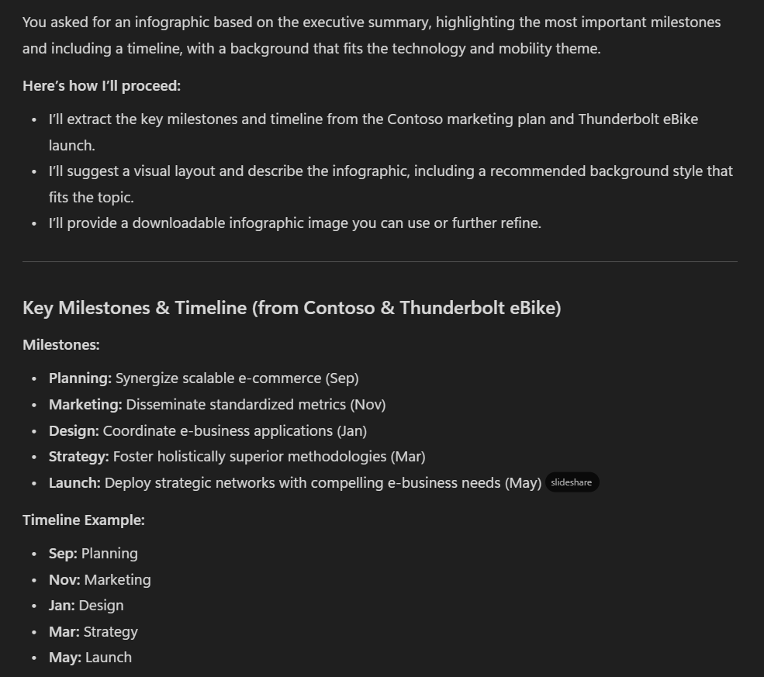
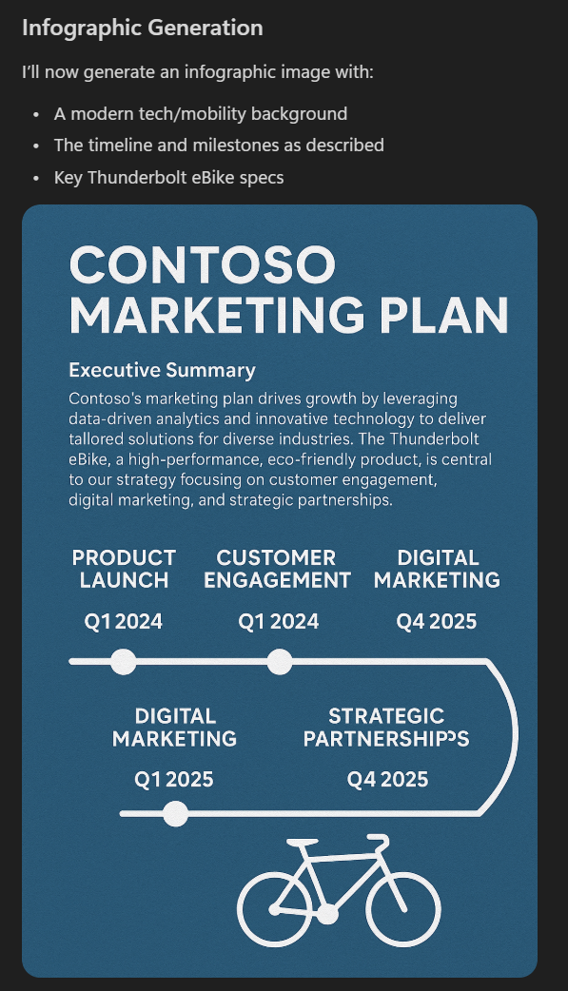
Create InfoGraphics
Documents are nice – but people tend to read through them. Based on our previous example we want to create an infographic showing the overall plan and steps. Let’s try this out
Generate a infrographic based on the exec summary
It should contain the most important milestones
Also the timeline should be included
Find a background that fit‘s the overall topic to illustrate the approach
Does the result fit your expectations? If not, give it another turn and Copilot Chat will adapt accordingly
If you are interested in diving deeper into the create features, follow this external link.
Notes:
Create InfoGraphics
Documents are nice – but people tend to read through them. Based on our previous example we want to create an infographic showing the overall plan and steps. Let’s try this out
Generate a infrographic based on the exec summary
It should contain the most important milestones
Also the timeline should be included
Find a background that fit‘s the overall topic to illustrate the approach
Does the result fit your expectations? If not, give it another turn and Copilot Chat will adapt accordingly
If you are interested in diving deeper into the create features, follow this external link.
To continue, click next

Slide 34
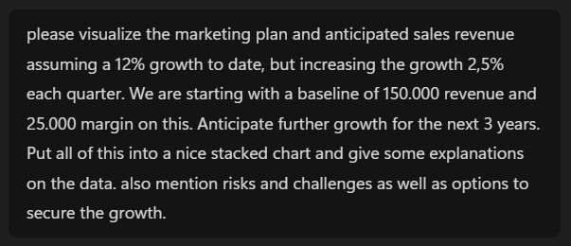
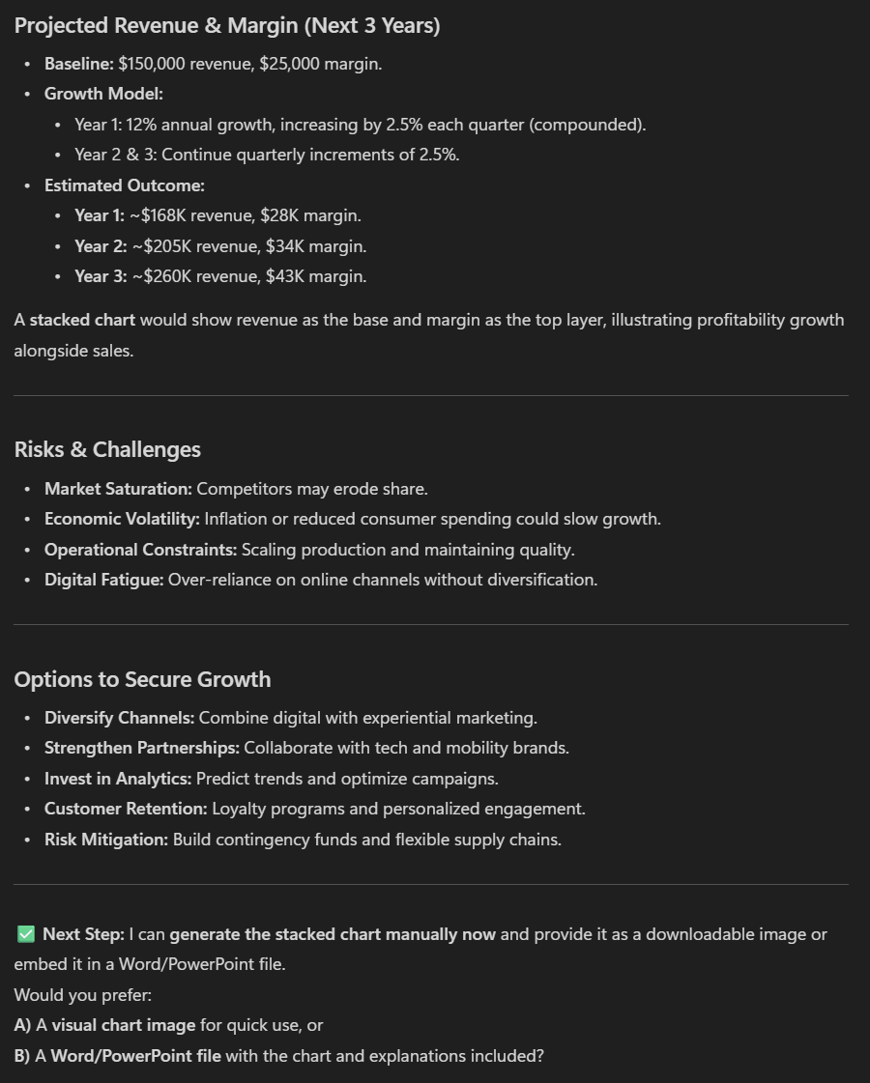
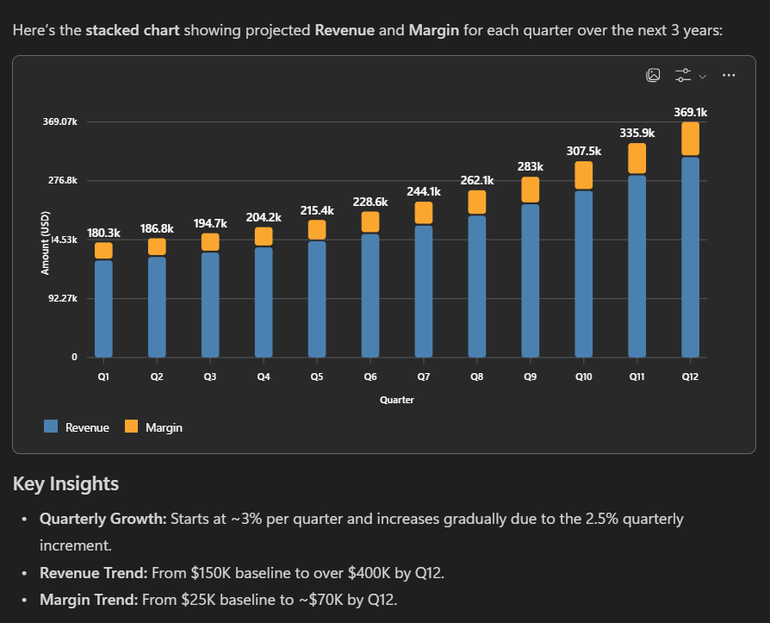
Visualize Data
Now, only one more thing to do. The Marketing plan has been set up and we see gaining traction on it. But our tables are a mess!
Upload another document, maybe an excel
It should contain some simple sample data
Let Copilot Chat create a stunning chart out of it
As always: specify what you need and iterate if the result doesn‘t meet your expectations
How did it work out for you?
If you are interested in diving deeper into the create features, follow this external link.
Notes:
Visualize Data
Now, only one more thing to do. The Marketing plan has been set up and we see gaining traction on it. But our tables are a mess!
Upload another document, maybe an excel
It should contain some simple sample data
Let Copilot Chat create a stunning chart out of it
As always: specify what you need and iterate if the result doesn‘t meet your expectations
How did it work out for you?
If you are interested in diving deeper into the create features, follow this external link.
To continue, click next

Slide 35
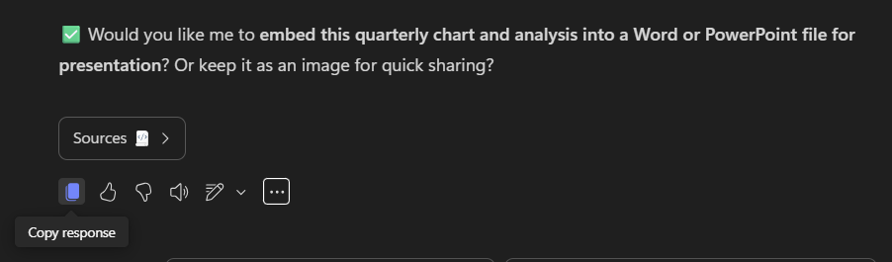
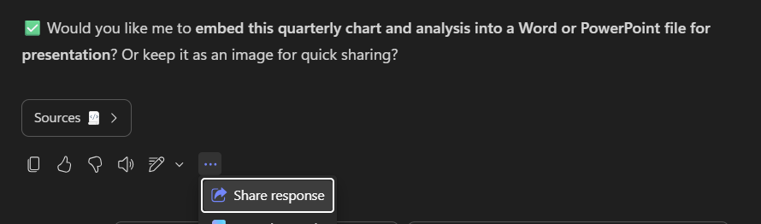
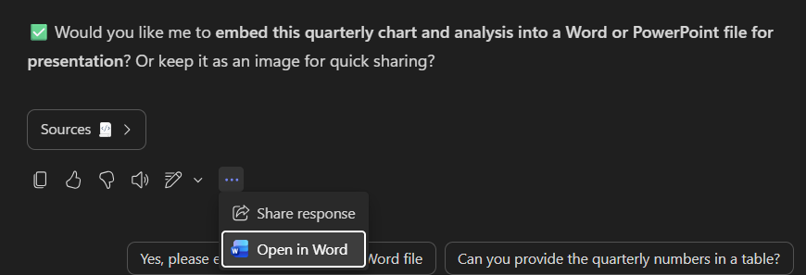
Share your results
Let’s be honest, in most cases we won’t be working on this on our own, wouldn’t we? So let’s share the results with our Coworkers!
There are different ways to share results
Simple and fast is to download the generated documents and pictures
More elaborated would be to just share the result
You’ll find the options to do so at the end of Copilots answer
Curious on additional sharing options? Then let’s continue!
Notes:
Share your results
Let’s be honest, in most cases we won’t be working on this on our own, wouldn’t we? So let’s share the results with our Coworkers!
There are different ways to share results
Simple and fast is to download the generated documents and pictures
More elaborated would be to just share the result
You’ll find the options to do so at the end of Copilots answer
Curious on additional sharing options? Then let’s continue!
To continue, click next

Slide 36
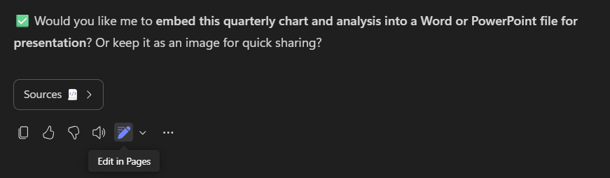
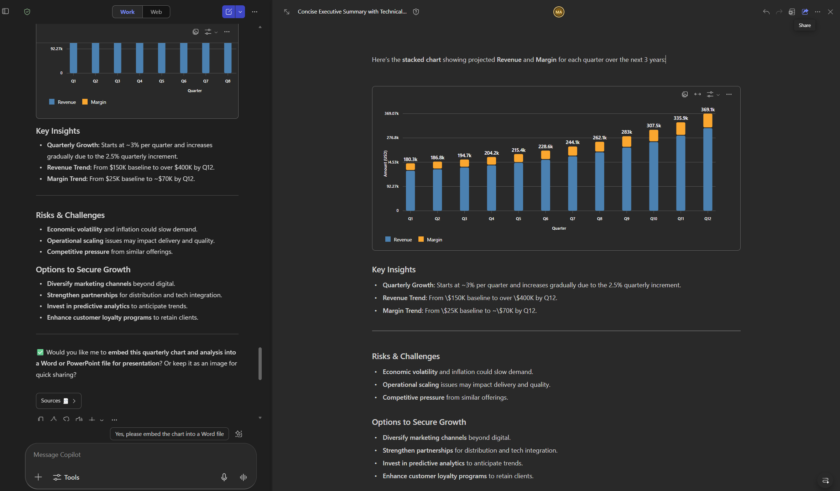

Copilot Pages
With Copilot Pages you are stepping on a collaborative level of sharing with your teammates – to achieve more together
It's your digital place for generating, organizing, and refining content in real-time
You chat with Copilot
Transfer Copilot’s response to a new page that opens side-by-side with Chat
And can continue your conversation with Copilot and add more responses to your page
Edit your page at any time – or share the page with colleagues
If you are interested in diving deeper into pages, follow this external link.
Notes:
Copilot Pages
With Copilot Pages you are stepping on a collaborative level of sharing with your teammates – to achieve more together
It's your digital place for generating, organizing, and refining content in real-time
You chat with Copilot
Transfer Copilot’s response to a new page that opens side-by-side with Chat
And can continue your conversation with Copilot and add more responses to your page
Edit your page at any time – or share the page with colleagues
If you are interested in diving deeper into pages, follow this external link.
To continue, click next

Slide 37
Module 3 recap
You made it through Module 3 - Enrich! We hope you enjoyed the time and are more than curious to continue.
If you just can’t stop and want to deepen the topics, use the additional links provided on the respective sites.
As a bonus, we also want you to know these valuable resources to further fuel your journey with Microsoft 365 Copilot Chat (external links):
Copilot Scenario Gallery – Best practices based on functional roles
Copilot Chat Prompt examples in weekly challenges
Additional Prompting Guidance
Copilot Prompt Gallery for inspiration
Microsoft help and learning center
Frequently asked questions about Copilot Chat
See you in the next module “Expand” to continue the journey.
🎉
Notes:
Module 3 recap
You made it through Module 3 - Enrich! We hope you enjoyed the time and are more than curious to continue.
If you just can’t stop and want to deepen the topics, use the additional links provided on the respective sites.
As a bonus, we also want you to know these valuable resources to further fuel your journey with Microsoft 365 Copilot Chat (external links):
Copilot Scenario Gallery – Best practices based on functional roles
Copilot Chat Prompt examples in weekly challenges
Additional Prompting Guidance
Copilot Prompt Gallery for inspiration
Microsoft help and learning center
Frequently asked questions about Copilot Chat
See you in the next module “Expand” to continue the journey.
To continue, click next

Slide 38
Module 4 - Expand
Overview on Copilot Extensions
Finding Agents
Agent Types
Limitations and Mitigations
Building own agents
Sharing agents
Notes:
Welcome to Module 4 – Expand
In this last episode we are focusing on going beyond the standard. We are going to cover:
Overview on Copilot Extensions
Finding Agents
Agent Types
Limitations and Mitigations
Building own agents
Sharing agents
To continue, click next

Slide 39
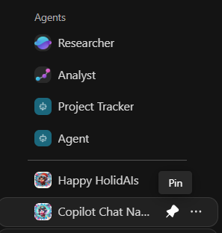
Extending Copilot Chat
Just when you thought you’ve seen it all…..there is one more thing to know about Microsoft 365 Copilot Chat.
All we‘ve seen until now has been what comes out of the box
But what if you could add even more functionality?
so-called agents extend the basis functionality, add specialized features or could even let you access additional applications
Remember already having used one? Yes, right! The Prompt Coach and the Idea Coach.
Let‘s see where to find more agents and integrations
Recently used agents are to be found in the left menu pane.
You can pin an agent by clicking the three dots and choosing „pin“.
Notes:
Extending Copilot Chat
Just when you thought you’ve seen it all…..there is one more thing to know about Microsoft 365 Copilot Chat.
All we‘ve seen until now has been what comes out of the box
But what if you could add even more functionality?
so-called agents extend the basis functionality, add specialized features or could even let you access additional applications
Remember already having used one? Yes, right! The Prompt Coach and the Idea Coach.
Recently used agents are to be found in the left menu pane.
You can pin an agent by clicking the three dots and choosing „pin“.
Let‘s see where to find more agents and integrations
To continue, click next

Slide 40
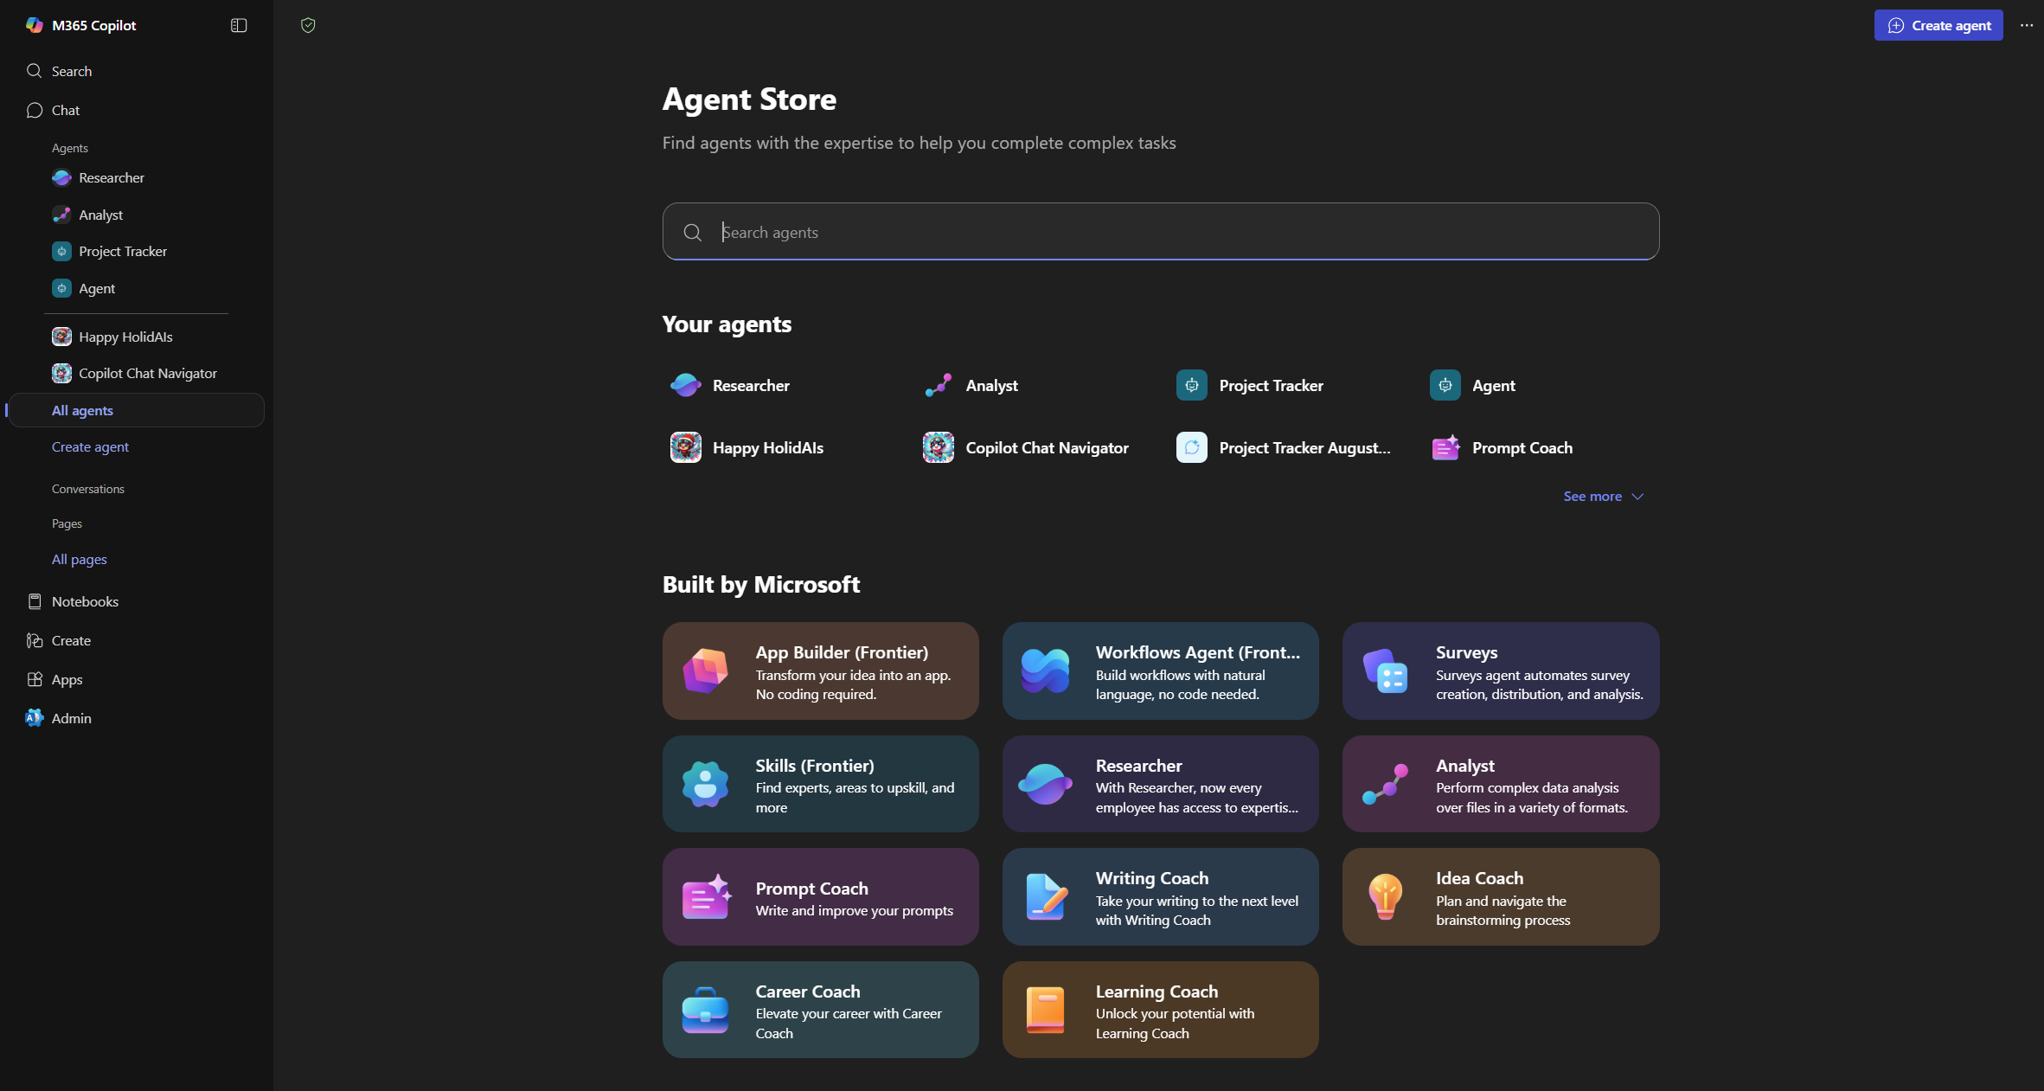


Find additional agents
Click „All Agents“ in the left menu pane, the Agent Store opens and you can search through all available agents.
Agents you already have been using or have installed will be listed as
Agents being built by colleagues and shared with you are listed as
Notes:
Find additional agents
Click „All Agents“ in the left menu pane, the Agent Store opens and you can search through all available agents.
Agents you already have been using or have installed will be listed as „Your agents“
Agents being built by colleagues and shared with you are listed as „built by your org“
To continue, click next

Slide 41
Different agent types
AI agents are grouped by how they make decisions and react to their environment. Some handle basic tasks, while others take on more complex challenges
Reactive agents handle input without storing past experiences and are ideal for simple, rule-based tasks
Model-based agents build a basic understanding of their environment. They use this to make informed decisions on what’s happening around them
Goal-based agents choose actions to make smart decisions with a clear outcome in mind
Utility-based agents evaluate outcomes and aim for the best possible result
Learning agents get and use new data to improve over time
Notes:
Different agent types
AI agents are grouped by how they make decisions and react to their environment. Some handle basic tasks, while others take on more complex challenges
Reactive agents handle input without storing past experiences and are ideal for simple, rule-based tasks
Model-based agents build a basic understanding of their environment. They use this to make informed decisions on what’s happening around them
Goal-based agents choose actions to make smart decisions with a clear outcome in mind
Utility-based agents evaluate outcomes and aim for the best possible result
Learning agents get and use new data to improve over time
To continue, click next

Slide 42
Limitations and mitigations
Be aware that not all agent types and integrations will be available when opening the agent store
Your organization controls which agents are available
Some agents can be used with Microsoft 365 Copilot Chat for free, others are being billed per use
Your administrator might have limited access to agents
If you are missing functionality or a specific agent which you know is existent, reach out to your support team
Notes:
Limitations and mitigations
Be aware that not all agent types and integrations will be available when opening the agent store
Your organization controls which agents are available
Some agents can be used with Microsoft 365 Copilot Chat for free, others are being billed per use
Your administrator might have limited access to agents
If you are missing functionality or a specific agent which you know is existent, reach out to your support team
To continue, click next

Slide 43
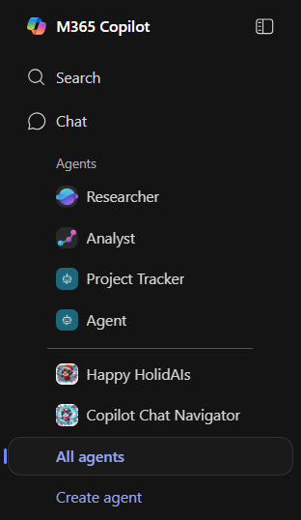

Create your own agent
Apart from technical or organizational limitations – what if you could build your very own agent, creating a specific functionality based on Copilot Chats model and knowledge.
Also with Microsoft 365 Copilot Chat, you‘ve got the possibility to create agents
Within the left menu pane you can click „Create Agent“
Or the according button within the Agent store
The so-called „Agent Builder“ opens which gives you the possibility to create an agent in an easy and straight-forward manner
Let‘s get an overview of it on the next page
Notes:
Create your own agent
Apart from technical or organizational limitations – what if you could build your very own agent, creating a specific functionality based on Copilot Chats model and knowledge.
Also with Microsoft 365 Copilot Chat, you‘ve got the possibility to create agents
Within the left menu pane you can click „Create Agent“
Or the according button within the Agent store
The so-called „Agent Builder“ opens which gives you the possibility to create an agent in an easy and straight-forward manner
Let‘s get an overview of it on the next page
To continue, click next

Slide 44


The agent Builder
Agent Builder can be used in two different ways
either just describe the functionality you need and it builds the agent itself
Or you can write the instructions and define the functionality yourself
You can also mix the approach, begin with description and continue with instructions
The agent you are building is a so-called declarative agent, because it‘s solely build on instructions without any code.
Your experience might differ.
Notes:
The agent Builder
Agent Builder can be used in two different ways
either just describe the functionality you need and it builds the agent itself
Or you can write the instructions and define the functionality yourself
You can also mix the approach, begin with description and continue with instructions
The agent you are building is a so-called declarative agent, because it‘s solely build on instructions without any code.
Your experience might differ.
To continue, click next

Slide 45



Describe your agent
By describing what your agent should do, the Agent Builder guides you through each step of the creation process
on the left side is what you want it to do
on the right you can test your agents functionality
You will see how your agents appearance on the right changes with every step you take.
It also creates suggested prompts for interaction.
When you are happy with the result, click „Create“ in the upper left corner.
And that‘s it!
Notes:
Describe your agent
By describing what your agent should do, the Agent Builder guides you through each step of the creation process
on the left side is what you want it to do
on the right you can test your agents functionality
You will see how your agents appearance on the right changes with every step you take.
It also creates suggested prompts for interaction.
To continue, click next

Slide 46


Configure your agent
The configuration of the agent gives you full flexibility
You can use up to 8.000 characters for instructions
You can define your own suggested prompts
Change the icon, name and description
Name specific websites where information lies
Awesome options like the ability to create pictures or code can be enabled or disabled.
When you are happy with the result, click „Create“ in the upper left corner.
And that‘s it!
Notes:
Configure your agent
The configuration of the agent gives you full flexibility
You can use up to 8.000 characters for instructions
You can define your own suggested prompts
Change the icon, name and description
Name specific websites where information lies
Awesome options like the ability to create pictures or code can be enabled or disabled.
When you are happy with the result, click „Create“ in the upper left corner.
And that‘s it!
To continue, click next

Slide 47


Share your agent
Let‘s be honest, this is not just like a new Word document, this is a personal highlight and „I made fire“ moment we want to share.
And in most cases the functionality is not only for personal use, but could also be helpful to others.
You decide if you want to share your agent or not.
And you decide with whom. Just some very selected colleagues, or your whole organization.
Just click the ellipses – which would also always give you the possibility to edit your agent. And if you don‘t want to share anymore – take the same path to revoke sharing.
Your administrator might have limited or disabled sharing options.
If you are interested in diving deeper into agent creation, follow this external link.
Notes:
Share your agent
Let‘s be honest, this is not just like a new Word document, this is a personal highlight and „I made fire“ moment we want to share.
And in most cases the functionality is not only for personal use, but cloud also be helpful to others.
You decide if you want to share your agent or not.
And you decide with whom. Just some very selected colleagues, or your whole organization.
Just click the ellipses – which would also always give you the possibility to edit your agent. And if you don‘t want to share anymore – take the same path to revoke sharing.
Your administrator might have limited or disabled sharing options.
To continue, click next

Slide 48
Module 4 recap
What a blaze – you made it, you did it! We hope you enjoyed the time. Now that you are more than ready to go – have a great time and joyful journey with Microsoft 365 Copilot Chat as Safe AI at work!
If you just can’t stop and want to deepen the topics, use the additional links provided on the respective sites.
As a bonus, we also want you to know these valuable resources to further fuel your journey (external links):
Declarative Agent example which uses almost full 8.000 characters, including sources and howto video
Get started with Agent Builder
Beyond agent builder
Get started with Copilot Studio
Create your first agent with Copilot Studio
Only one more step and we close this session.
🎉
Notes:
Module 4 recap
What a blaze – you made it, you did it! We hope you enjoyed the time. Now that you are more than ready to go – have a great time and joyful journey with Microsoft 365 Copilot Chat as Safe AI at work!
If you just can’t stop and want to deepen the topics, use the additional links provided on the respective sites.
As a bonus, we also want you to know these valuable resources to further fuel your journey (external links):
Declarative Agent example which uses almost full 8000 characters, including sources and howto video
Get started with Agent Builder
Beyond agent builder
Get started with Copilot Studio
Create your first agent with Copilot Studio
Only one more step and we close this session.
To continue, click next

Slide 49

closing
We‘re done! Time to celebrate yourself!
Open Copilot Chat and create yourself an achievement badge. You maybe want to incorporate your organization or your name, have fun, make it yours, share with pride.
Only one last thing: if you want to stay up to date, follow the 👉 Copilot Blog
Cheers!
Notes:
Closing
We‘re done! Time to celebrate yourself!
Open Copilot Chat and create yourself an achievement badge. You maybe want to incorporate your organization or your name, have fun, make it yours, share with pride.
Only one last thing: if you want to stay up to date, follow the 👉 Copilot Blog
Cheers!

